Slide 1


Noida Institute of Engineering and Technology, Greater Noida
Statistical Technique-II
Unit: II
Subject Name: Mathematics-IV
Subject Code: AAS0301A
Dr. Kunti Mishra
NIET, Gr Noida
Department of
Mathematics
B Tech 4th Sem

Slide 2

BRIEF INTRODUCTION OF FACULTY
Dr. Kunti Mishra
Assistant Professor
Department of Mathematics
Qualifications :
M.Sc.(Maths), M. Tech.(Gold Medalist) in Applied and Computational Mathematics, Ph.D
Ph.D. Thesis : Some Investigations in Fractal Theory
Total Number of Research Papers:15
Area of Interests: Fixed Point Theory, Fractals
Teaching Experience: 9 years

Slide 3
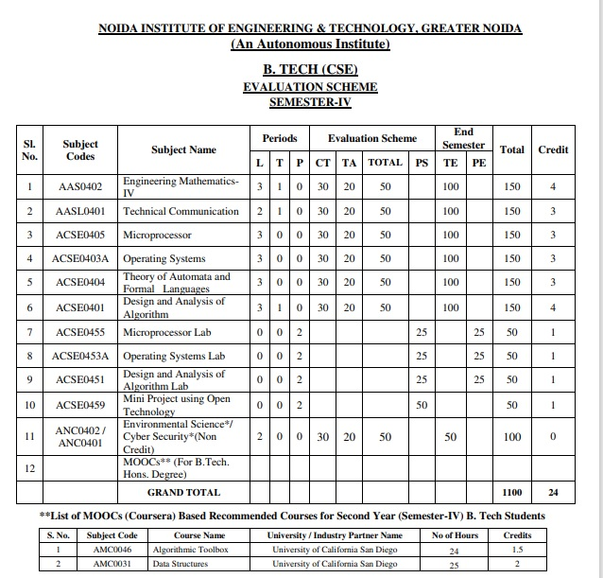
Evaluation Scheme

Slide 4
Syllabus
Unit-I (Statistical Techniques-I)
Introduction: Measures of central tendency: Mean, Median, Mode, Moment, Skewness, Kurtosis, Curve Fitting ,Method of least squares, Fitting of straight lines, Fitting of second degree parabola, Exponential curves ,Correlation and Rank correlation, Linear regression, nonlinear regression and multiple linear regression
Unit-II (Statistical Techniques-II)
Testing a Hypothesis, Null hypothesis, Alternative hypothesis, Level of significance, Confidence limits, p-value, Test of significance of difference of means, Z-test, t-test and Chi-square test, F-test, ANOVA: One way and Two way. Statistical Quality Control (SQC), Control Charts, Control Charts for variables (Mean and Range Charts), Control Charts for Variables ( p, np and C charts).

Slide 5
Syllabus
Unit III (Probability and Random Variable)
Random Variable: Definition of a Random Variable, Discrete Random Variable, Continuous Random Variable, Probability mass function, Probability Density Function, Distribution functions.
Multiple Random Variables: Joint density and distribution Function, Properties of Joint Distribution function, Marginal density Functions, Conditional Distribution and Density, Statistical Independence, Central Limit Theorem (Proof not expected).
Unit IV (Expectations and Probability Distribution)
Operation on One Random Variable – Expectations: Introduction, Expected Value of a Random Variable, Mean, Variance, Moment Generating Function, Binomial, Poisson, Normal, Exponential distribution.

Slide 6
Syllabus
Unit V (Wavelets and applications and Aptitude-IV)
Wavelet Transform, wavelet series. Basic wavelets (Haar/Shannon/Daubechies), orthogonal wavelets, multi-resolution analysis, reconstruction of wavelets and applications.
Number System, Permutation & Combination, Probability, Function, Data Interpretation, Syllogism.

Slide 7
Branch Wise Application
Data Analysis
Artificial intelligence
Network and Traffic modeling

Slide 8
Course Objective
The objective of this course is to familiarize the students with statistical techniques. It aims to present the students with standard concepts and tools at an intermediate to superior level that will provide them well towards undertaking a variety of problems in the discipline.
The students will learn:
Understand the concept of correlation, moments, skewness and kurtosis and curve fitting.
Apply the concept of hypothesis testing and statistical quality control to create control charts.
Remember the concept of probability to evaluate probability distributions.
Understand the concept of Mathematical Expectations and Probability Distribution.
Remember the concept of Wavelet Transform and Solve the problems of Number System, Permutation & Combination, Probability, Function, Data Interpretation, Syllogism.

Slide 9
Course Outcome
CO1: Understand the concept of correlation, moments, skewness and kurtosis and curve fitting.
CO2: Apply the concept of hypothesis testing and statistical quality control to create control charts.
CO3: Remember the concept of probability to evaluate probability distributions
CO4: Understand the concept of Mathematical Expectations and Probability Distribution
CO5: Remember the concept of Wavelet Transform and Solve the problems of Number System, Permutation & Combination, Probability, Function, Data Interpretation, Syllogism.

Slide 10
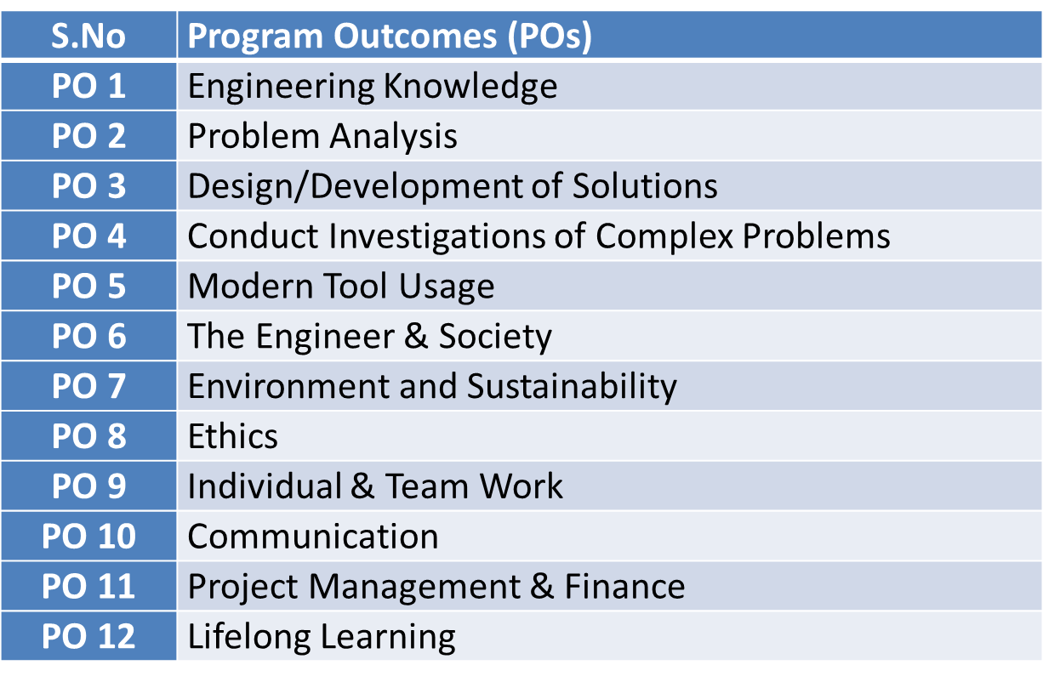
Program Outcome

Slide 11
PSO
PSO | Program Specific Outcomes(PSOs)
PSO1 | The ability to identify, analyze real world problems and design their ethical solutions using artificial intelligence, robotics, virtual/augmented reality, data analytics, block chain technology, and cloud computing
PSO2 | The ability to design and develop the hardware sensor devices and related interfacing software systems for solving complex engineering problems.
PSO3 | The ability to understand inter disciplinary computing techniques and to apply them in the design of advanced computing.
PSO4 | The ability to conduct investigation of complex problem with the help of technical, managerial, leadership qualities, and modern engineering tools provided by industry sponsored laboratories.

Slide 12
CO-PO Mapping(CO1)
Sr. No | Course Outcome | PO1 | PO2 | PO3 | PO4 | PO5 | PO6 | PO7 | PO8 | PO9 | PO10 | PO11 | PO12
1 | CO1 | H | H | H | H | L | L | L | L | L | L | L | M
2 | CO2 | H | H | H | H | L | L | L | L | L | L | M | M
3 | CO3 | H | H | H | H | L | L | L | L | L | L | M | M
4 | CO4 | H | H | H | H | L | L | L | L | L | L | L | M
5 | CO5 | H | H | H | H | L | L | L | L | L | L | M | M
*L= Low *M= Medium *H= High

Slide 13
CO-PSO Mapping(CO2)
CO | PSO1 | PSO2 | PSO3 | PSO4
CO.1 | H | L | M | L
CO.2 | L | M | L | M
CO.3 | M | M | M | M
CO.4 | H | M | M | M
CO.5 | H | M | M | M
*L= Low *M= Medium *H= High

Slide 14
Program Educational Objectives(PEOs)
PEO-1: To have an excellent scientific and engineering breadth so as to comprehend, analyze, design and provide sustainable solutions for real-life problems using state-of-the-art technologies.
PEO-2: To have a successful career in industries, to pursue higher studies or to support entrepreneurial endeavors and to face the global challenges.
PEO-3: To have an effective communication skills, professional attitude, ethical values and a desire to learn specific knowledge in emerging trends, technologies for research, innovation and product development and contribution to society.
PEO-4: To have life-long learning for up-skilling and re-skilling for successful professional career as engineer, scientist, entrepreneur and bureaucrat for betterment of society.

Slide 15
Result Analysis
Branch | Semester | Sections | No. of enrolled Students | No. Passed Students | % Passed
CS | IV | A | 67 | 65 | 92%
IOT | IV | A | 49 | 45 | 91.83%

Slide 16
End Semester Question Paper Template
Link:100 Marks Question Paper Template.docx

Slide 17
Prerequisite and Recap(CO2)
Knowledge of Mathematics I ,II and III of B. Tech or equivalent.

Slide 18
Brief Introduction about the Subject with Video Links
In first four modules, we will discuss Statistics.
In 5th module we will discuss wavelet Transform & aptitude part.
Video Links:
https://youtu.be/cKakQI_jl3w
https://youtu.be/bMSYgnrM-zw
https://youtu.be/mZ-FREAgCyY

Slide 19
Unit Content
Testing a Hypothesis,
Null hypothesis
Alternative hypothesis
Level of significance
Confidence limits
p-value
Test of significance of difference of means:
Z-test
t-test
Chi-square test
F-test
ANOVA: One way and Two way
Statistical Quality Control (SQC)
Control Charts
Control Charts for variables (Mean and Range Charts)
Control Charts for Variables ( p, np and C charts).

Slide 20
Unit Objective(CO2)
The objective of this course is to familiarize the engineers with Statistical techniques and its applications in real world.
The concept of hypothesis, ANOVA and quality control by control charts.

Slide 21
Topic objective (CO2)
Test of Hypothesis
Describe real-life examples to explain the motivation behind hypothesis

Slide 22
Test of Hypothesis (CO2)
Test of Hypothesis:
Some information about a characteristic of the population is known, we wish to know whether the information can be accepted or rejected, we choose a random sample and obtain information about the characteristic, based on this information.
we conclude whether the available information of the characteristic of the population can be accepted or rejected. This is called Test of hypothesis.

Slide 23
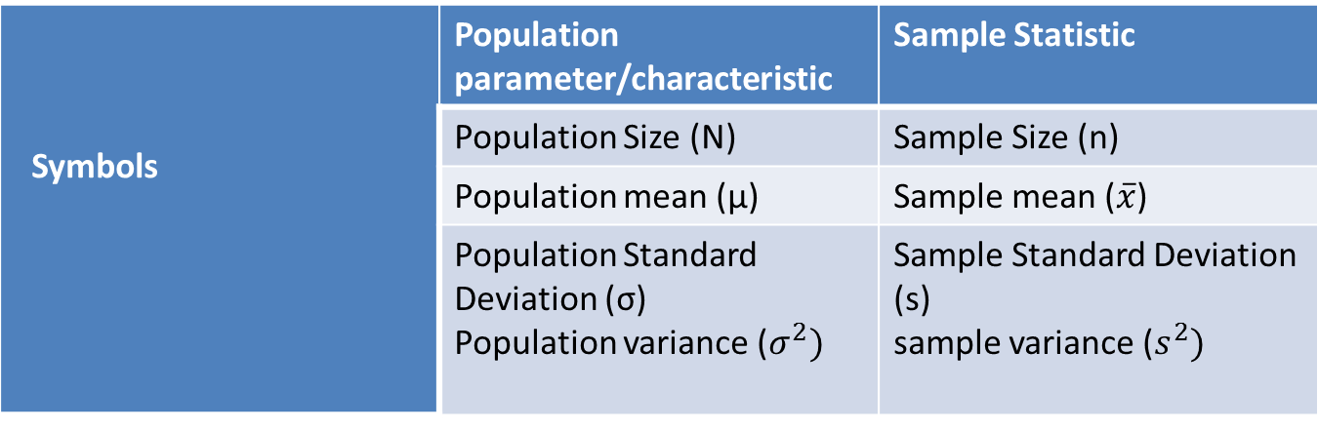
Test of Hypothesis (CO2)
Symbols for Population & Samples:

Slide 24
Test of Hypothesis (CO2)
Procedure of Test of hypothesis
State Null hypothesis & Alternate hypothesis
Define level of significance
Use suitable test statistics
Establish critical region (Table value)
Conclusion

Slide 25
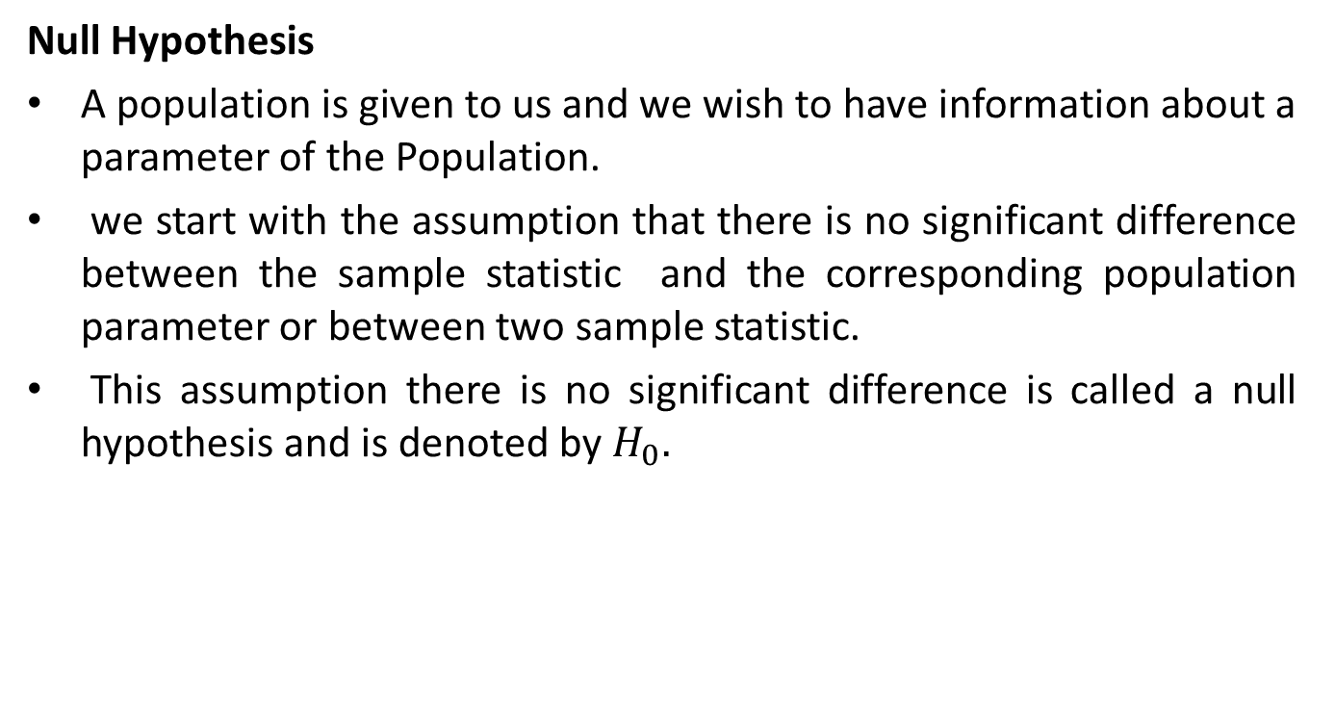
Test of Hypothesis (CO2)
Null Hypothesis
A population is given to us and we wish to have information about a parameter of the Population.
we start with the assumption that there is no significant difference between the sample statistic and the corresponding population parameter or between two sample statistic.
This assumption there is no significant difference is called a null hypothesis and is denoted by $H_{0}.$

Slide 26
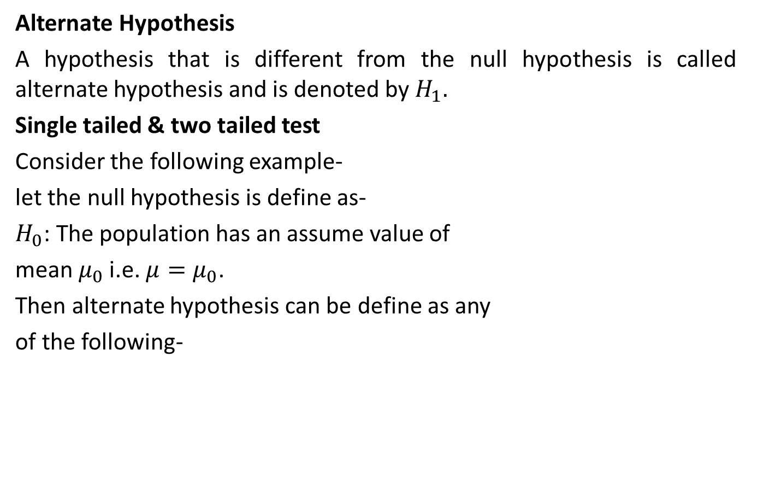
Test of Hypothesis (CO2)
Alternate Hypothesis
A hypothesis that is different from the null hypothesis is called alternate hypothesis and is denoted by $H_{1}.$
Single tailed & two tailed test
Consider the following example-
let the null hypothesis is define as-
$H_{0}$: The population has an assume value of
mean $μ_{0}$ i.e. $μ=μ_{0}$.
Then alternate hypothesis can be define as any
of the following-

Slide 27
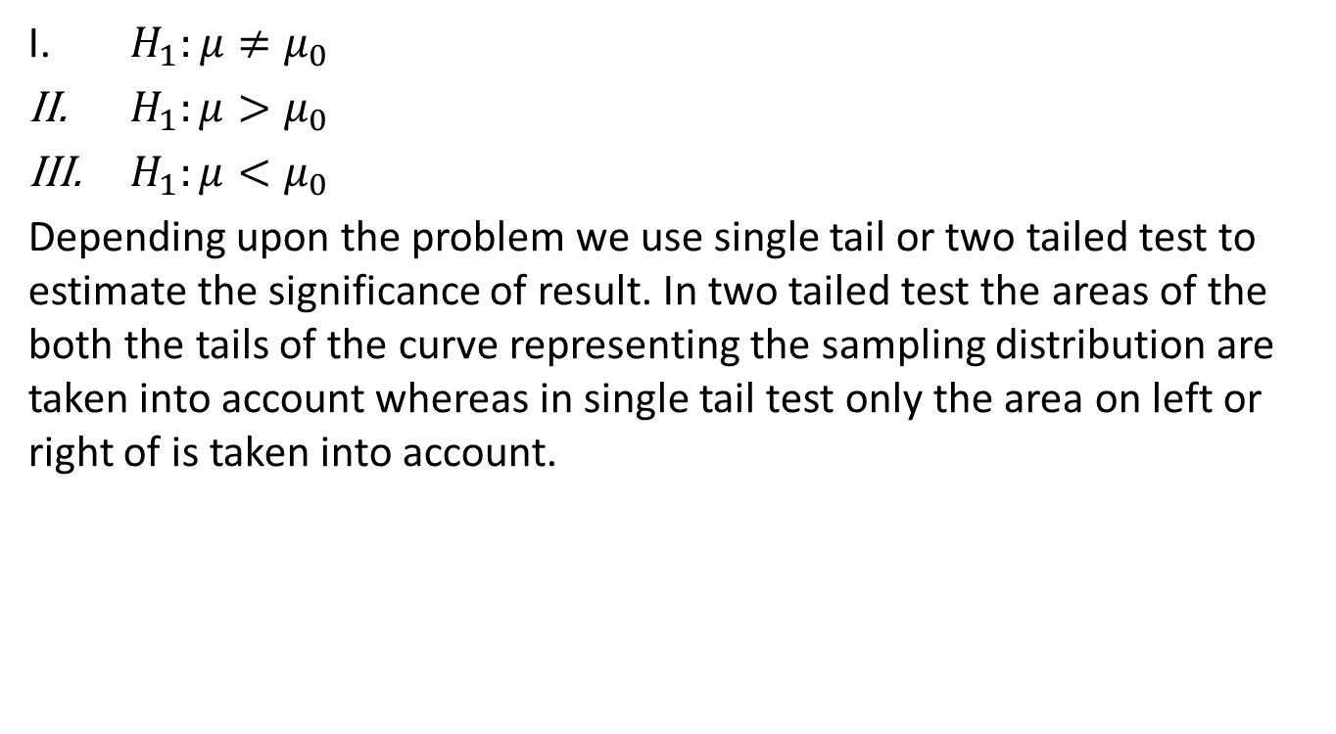
Test of Hypothesis (CO2)
$H_{1}:μ≠μ_{0}$
${ H}_{1}:μ>μ_{0}$
${ H}_{1}:μ<μ_{0}$
Depending upon the problem we use single tail or two tailed test to estimate the significance of result. In two tailed test the areas of the both the tails of the curve representing the sampling distribution are taken into account whereas in single tail test only the area on left or right of is taken into account.

Slide 28
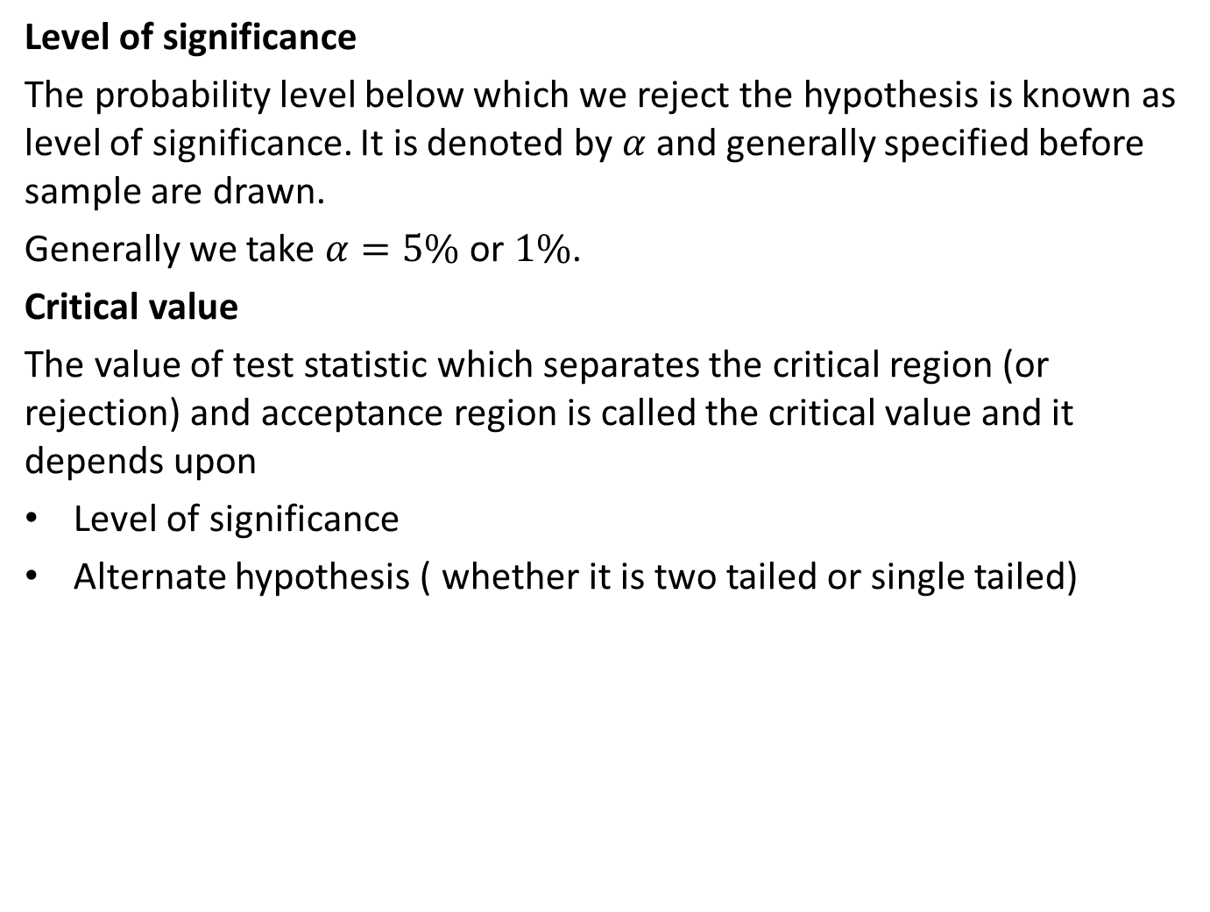
Test of Hypothesis (CO2)
Level of significance
The probability level below which we reject the hypothesis is known as level of significance. It is denoted by $α$ and generally specified before sample are drawn.
Generally we take $α=5\%$ or $1\%$.
Critical value
The value of test statistic which separates the critical region (or rejection) and acceptance region is called the critical value and it depends upon
Level of significance
Alternate hypothesis ( whether it is two tailed or single tailed)

Slide 29
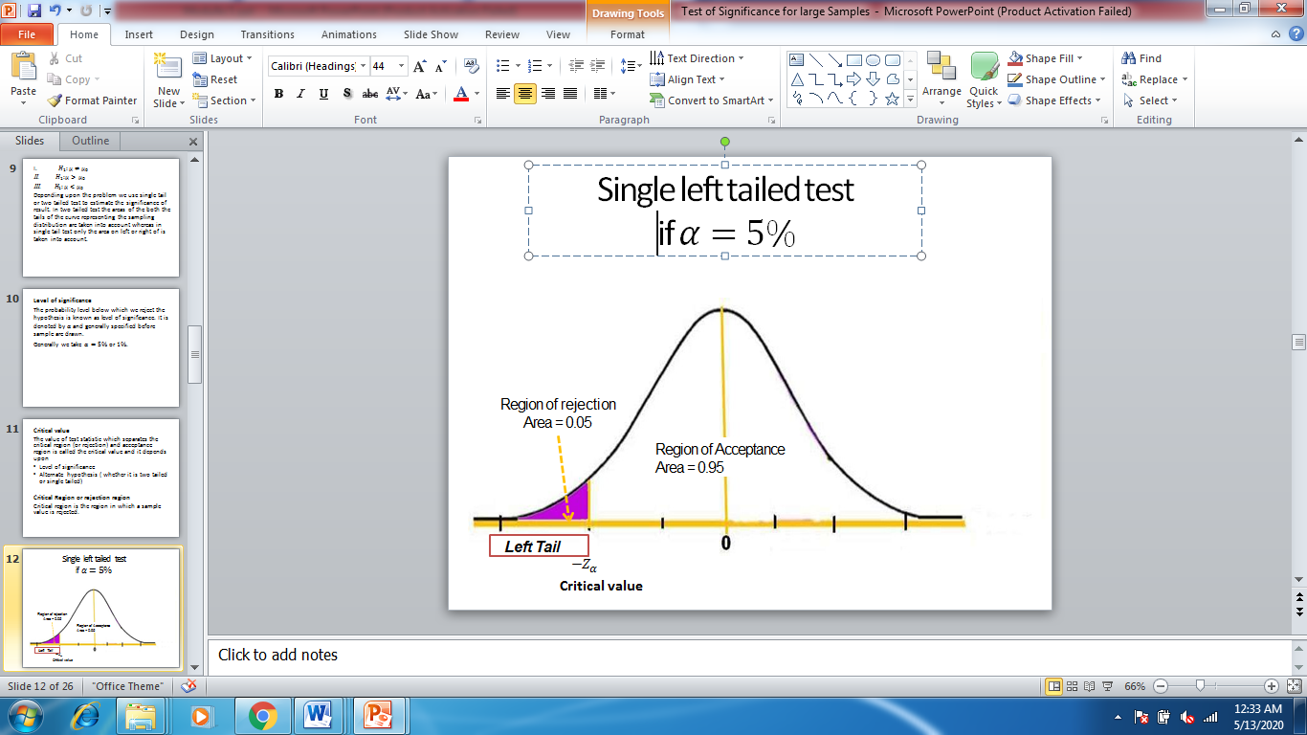
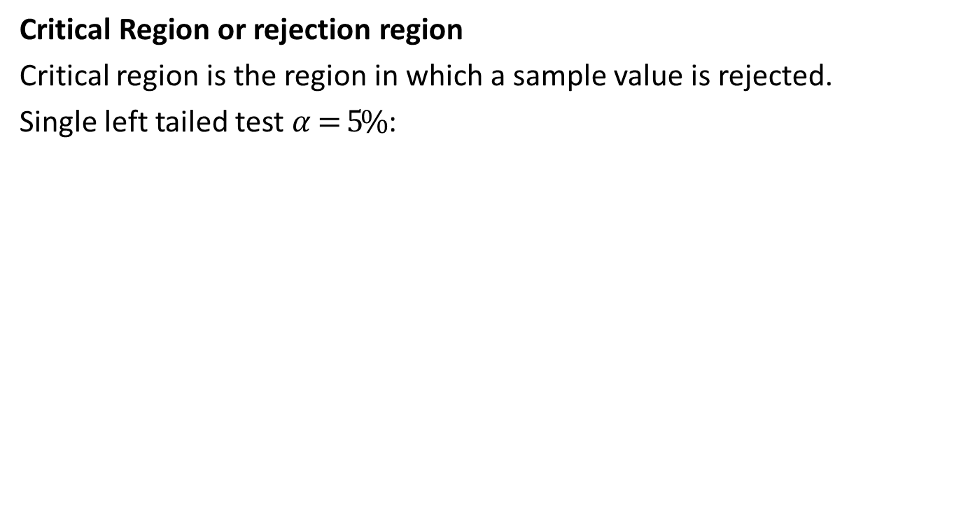
Test of Hypothesis (CO2)
Critical Region or rejection region
Critical region is the region in which a sample value is rejected.
Single left tailed test $α=5\%$ :

Slide 30
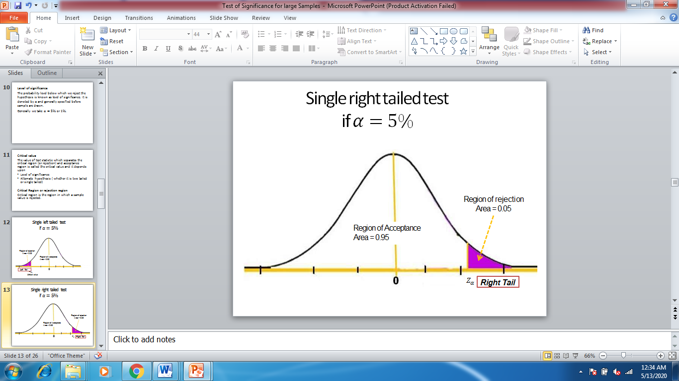
Test of Hypothesis (CO2)

Slide 31
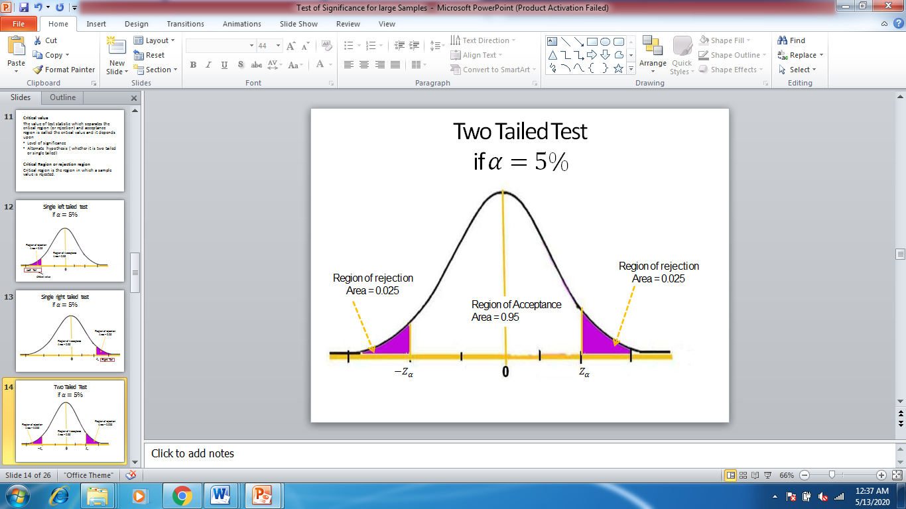
Test of Hypothesis (CO2)

Slide 32
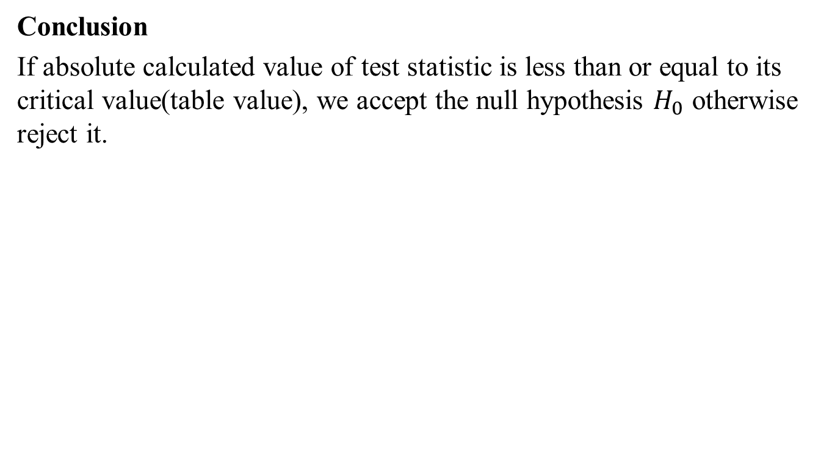
Test of Hypothesis (CO2)
Conclusion
If absolute calculated value of test statistic is less than or equal to its critical value(table value), we accept the null hypothesis $H_{0}$ otherwise reject it.

Slide 33
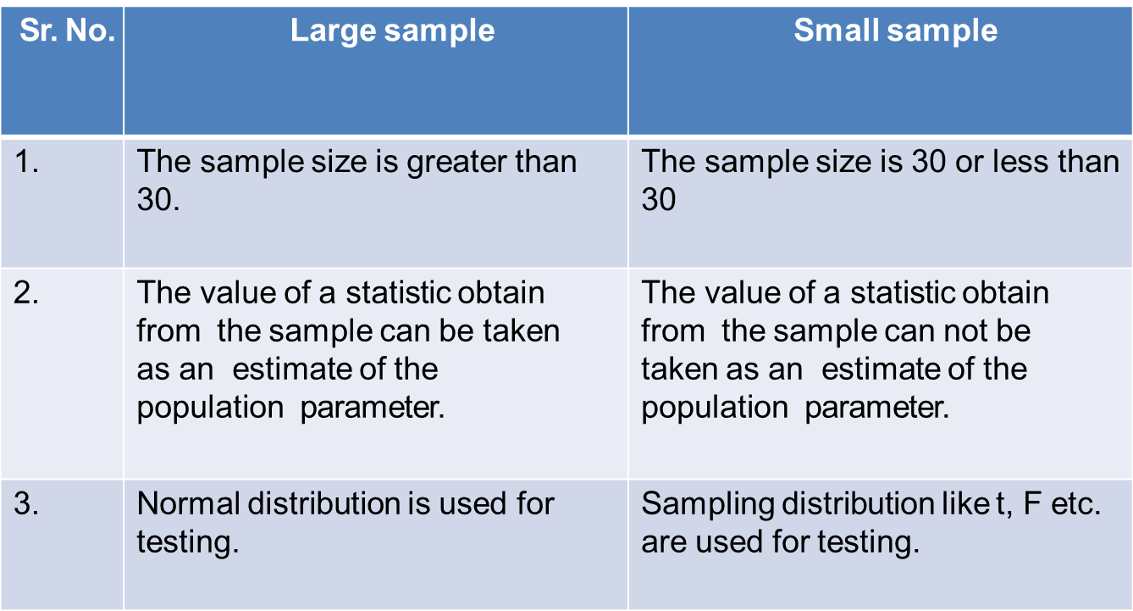
Test of Hypothesis (CO2)
Test of hypothesis for large samples and Small samples
Difference between Large and Small sample

Slide 34
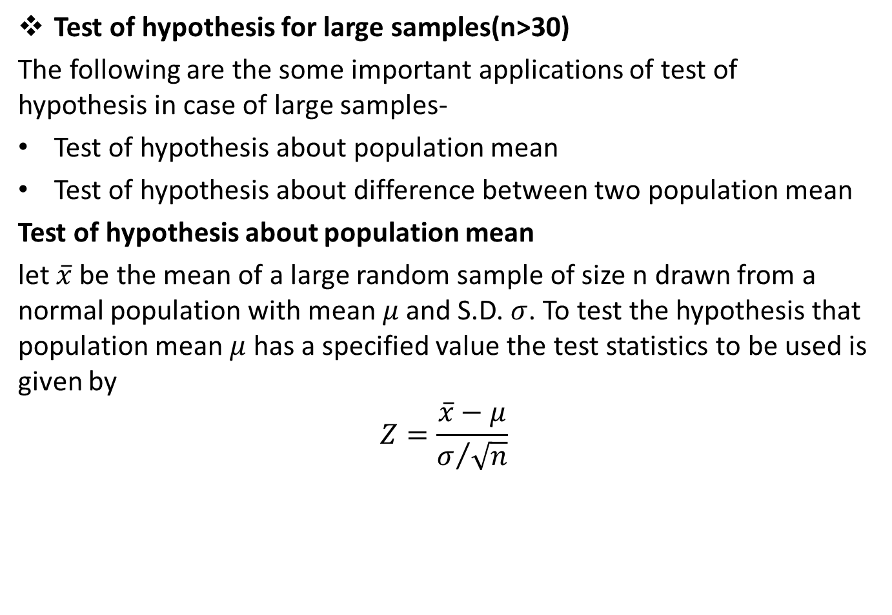
Test of Hypothesis (CO2)
Test of hypothesis for large samples(n>30)
The following are the some important applications of test of hypothesis in case of large samples-
Test of hypothesis about population mean
Test of hypothesis about difference between two population mean
Test of hypothesis about population mean
let $\overline{x}$ be the mean of a large random sample of size n drawn from a normal population with mean $μ$ and S.D. $σ$. To test the hypothesis that population mean $μ$ has a specified value the test statistics to be used is given by
$$Z=\frac{\overline{x}−μ}{σ/{\sqrt{n}}}$$

Slide 35
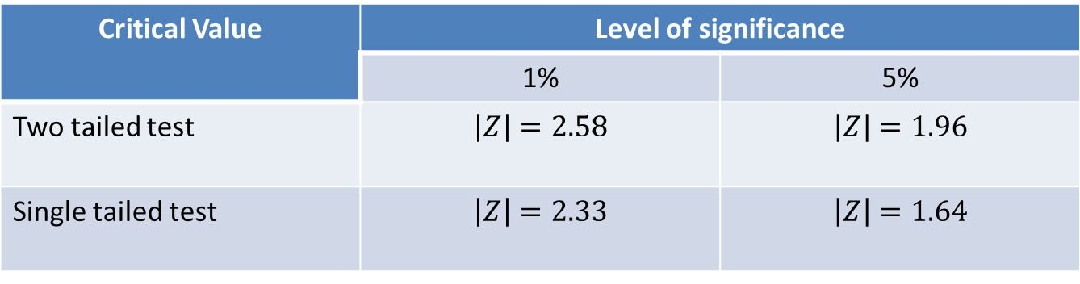
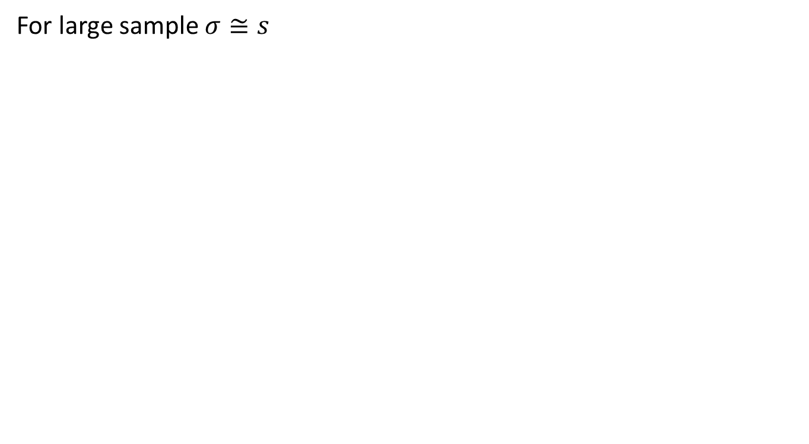
Test of Hypothesis (CO2)
For large sample $σ≅s$

Slide 36
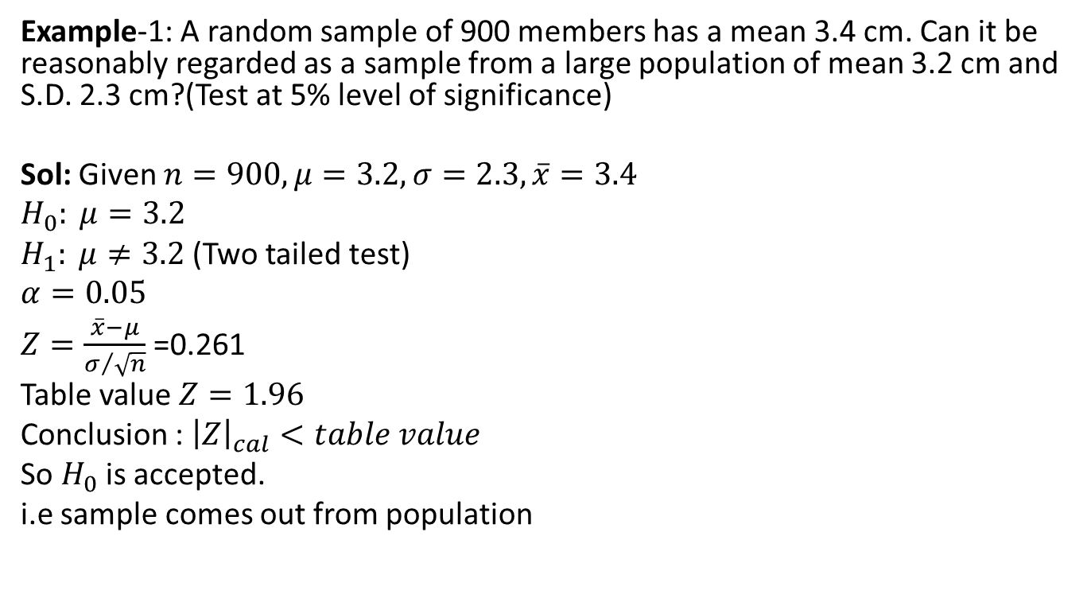
Test of Hypothesis (CO2)
Example-1: A random sample of 900 members has a mean 3.4 cm. Can it be reasonably regarded as a sample from a large population of mean 3.2 cm and S.D. 2.3 cm?(Test at 5% level of significance)
Sol: Given $n=900, μ=3.2, σ=2.3,\overline{x}=3.4$
$$H_{0}: μ=3.2$$
$H_{1}: μ≠3.2$(Two tailed test)
$$α=0.05$$
$Z=\frac{\overline{x}−μ}{σ/{\sqrt{n}}}$ =0.261
Table value $Z=1.96$
Conclusion : ${\left|Z\right|}_{cal}<table value$
So $H_{0}$ is accepted.
i.e sample comes out from population

Slide 37
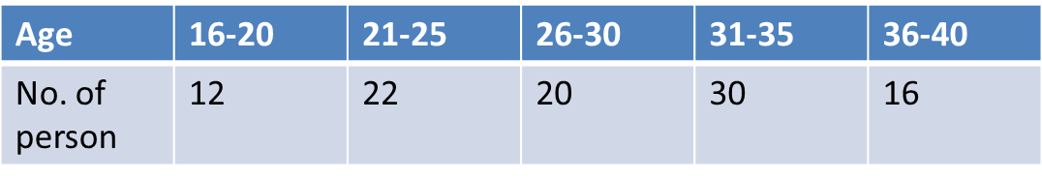
Test of Hypothesis (CO2)
Example-2: An insurance agent has claimed that the avg. age of policy holders who insure through him is less then the avg. age of all agents which is 30.5 yrs.
A random sample of 100 policy holders who had insured through him gave the following age distribution-
Calculate arithmetic mean and standard deviation(S.D.) of this distribution and test his claim at 5% level of significance.

Slide 38
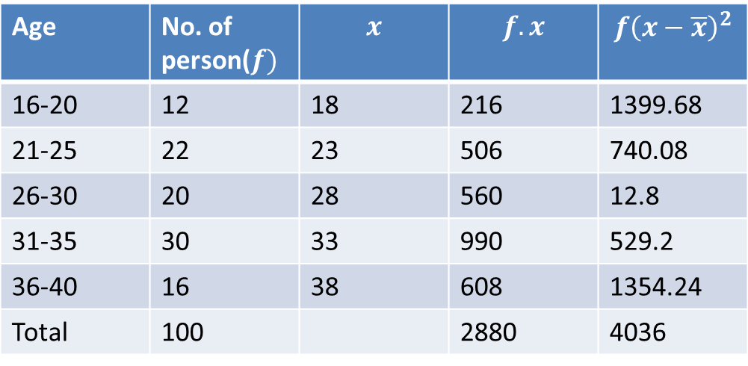
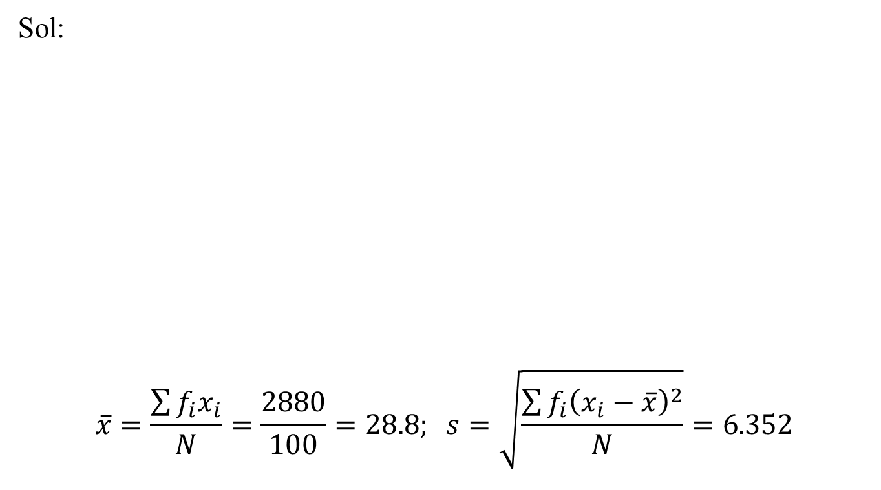
Test of Hypothesis (CO2)
Sol:
$$\overline{x}=\frac{\sum{f_{i}x_{i}}}{N}=\frac{2880}{100}=28.8; s=\sqrt{\frac{\sum{f_{i}{\left(x_{i}−\overline{x}\right)}^{2}}}{N}}=6.352$$

Slide 39
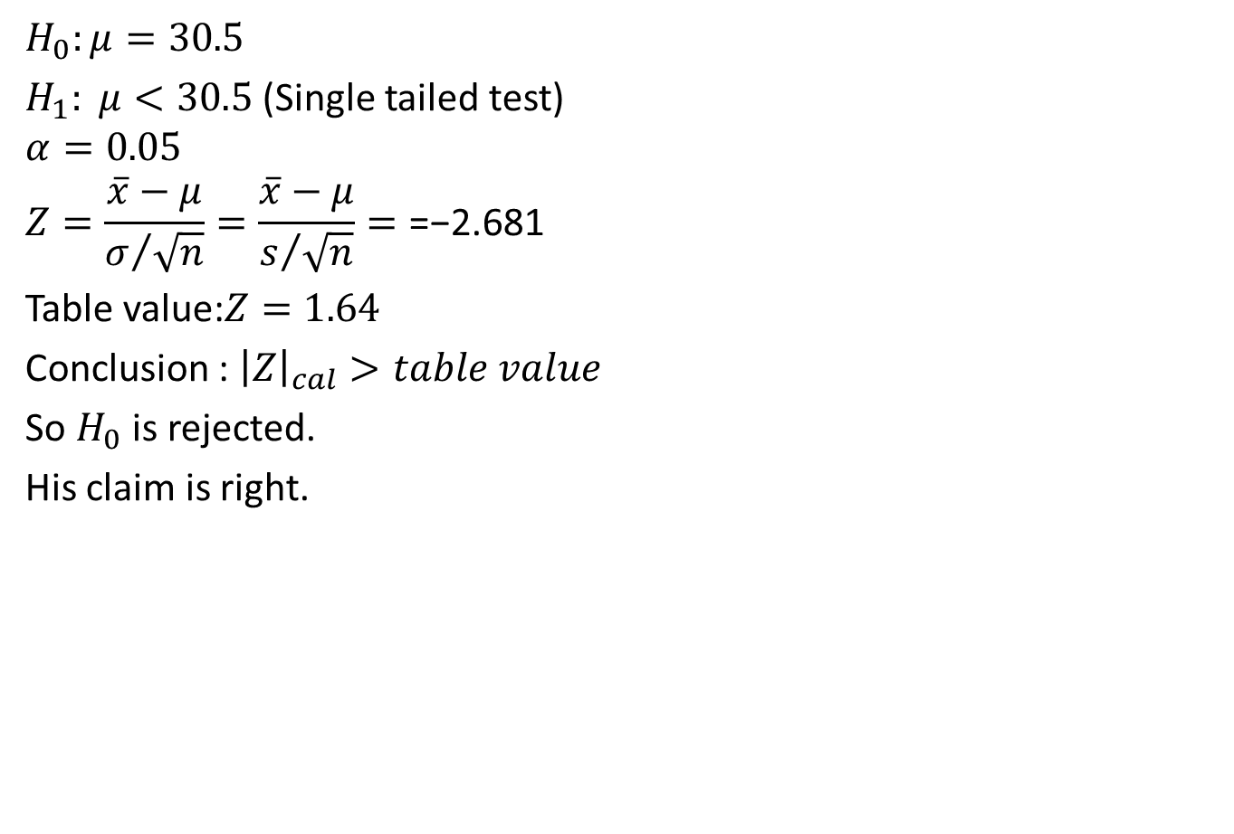
Test of Hypothesis (CO2)
$$H_{0}:μ=30.5$$
$H_{1}: μ<30.5$ (Single tailed test)
$$α=0.05$$
$$Z=\frac{\overline{x}−μ}{σ/{\sqrt{n}}}=\frac{\overline{x}−μ}{s/{\sqrt{n}}}=\text{=−2.681}$$
Table value:$Z=1.64$
Conclusion : ${\left|Z\right|}_{cal}>table value$
So $H_{0}$ is rejected.
His claim is right.

Slide 40
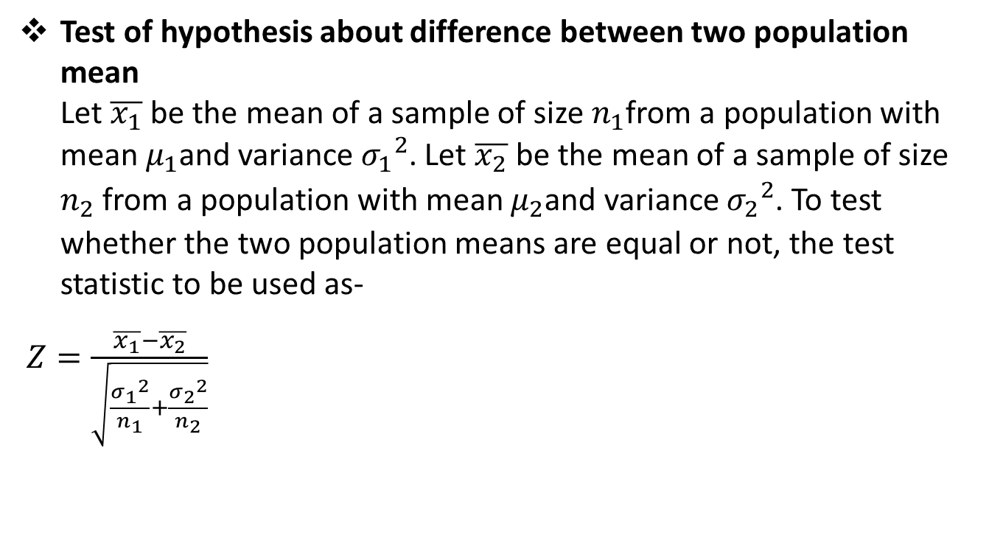
Test of Hypothesis (CO2)
Test of hypothesis about difference between two population mean Let $\overline{x_{1}}$ be the mean of a sample of size $n_{1}$from a population with mean $μ_{1}$and variance ${σ_{1}}_{ }^{2}$. Let $\overline{x_{2}}$ be the mean of a sample of size $n_{2}$ from a population with mean $μ_{2}$and variance ${σ_{2}}_{ }^{2}$. To test whether the two population means are equal or not, the test statistic to be used as-
$Z=\frac{\overline{x_{1}}−\overline{x_{2}}}{\sqrt{\frac{{σ_{1}}_{ }^{2}}{n_{1}}+\frac{{σ_{2}}_{ }^{2}}{n_{2}}}}$

Slide 41
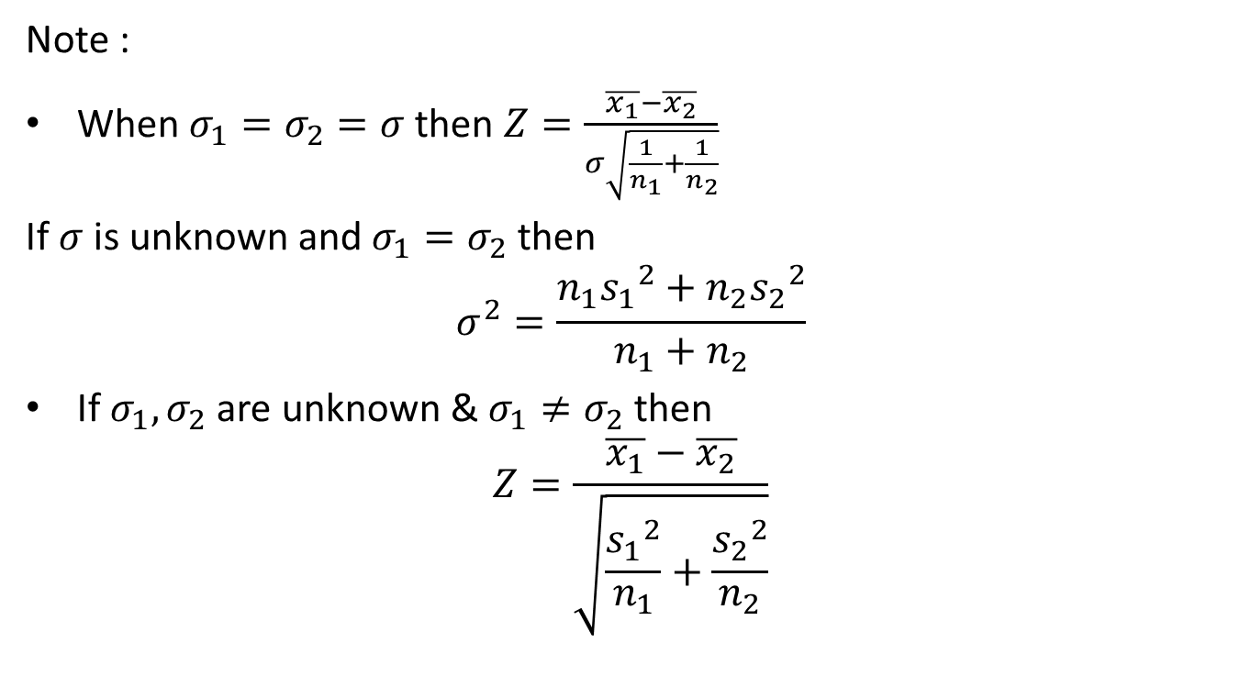
Test of Hypothesis (CO2)
Note :
When $σ_{1}=σ_{2}=σ$then $Z=\frac{\overline{x_{1}}−\overline{x_{2}}}{σ\sqrt{\frac{1}{n_{1}}+\frac{1}{n_{2}}}}$
If $σ$ is unknown and $σ_{1}=σ_{2}$ then
$$σ^{2}=\frac{n_{1}{s_{1}}_{ }^{2}+n_{2}{s_{2}}_{ }^{2}}{n_{1}+n_{2}}$$
If $σ_{1},σ_{2}$ are unknown & $σ_{1}≠σ_{2}$ then
$$Z=\frac{\overline{x_{1}}−\overline{x_{2}}}{\sqrt{\frac{{s_{1}}_{ }^{2}}{n_{1}}+\frac{{s_{2}}_{ }^{2}}{n_{2}}}}$$

Slide 42
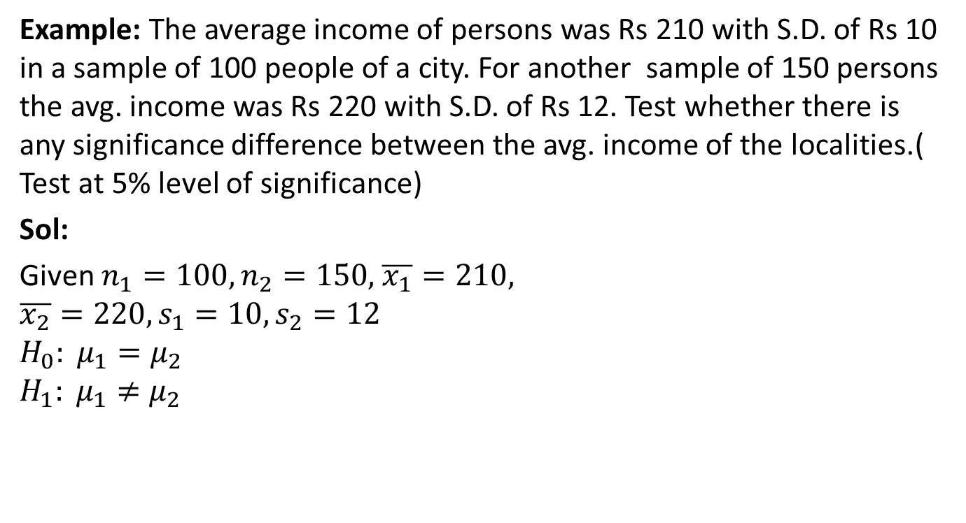
Test of Hypothesis (CO2)
Example: The average income of persons was Rs 210 with S.D. of Rs 10 in a sample of 100 people of a city. For another sample of 150 persons the avg. income was Rs 220 with S.D. of Rs 12. Test whether there is any significance difference between the avg. income of the localities.( Test at 5% level of significance)
Sol:
Given $n_{1}=100,n_{2}=150,$ $\overline{x_{1}}=210,$
$$\overline{x_{2}}=220, s_{1}=10,s_{2}=12$$
$$H_{0}: μ_{1}=μ_{2}$$
$$H_{1}: μ_{1}≠μ_{2}$$

Slide 43
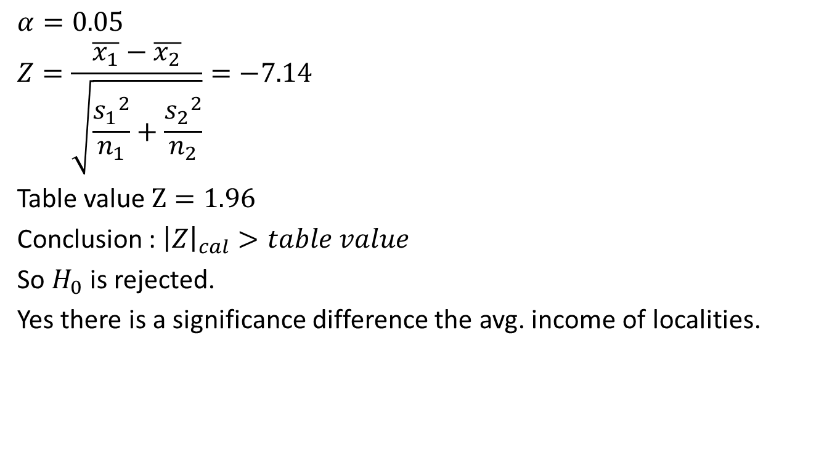
Test of Hypothesis (CO2)
$$α=0.05$$
$$Z=\frac{\overline{x_{1}}−\overline{x_{2}}}{\sqrt{\frac{{s_{1}}_{ }^{2}}{n_{1}}+\frac{{s_{2}}_{ }^{2}}{n_{2}}}}=−7.14$$
Table value $Z=1.96$
Conclusion : ${\left|Z\right|}_{cal}>table value$
So $H_{0}$ is rejected.
Yes there is a significance difference the avg. income of localities.

Slide 44
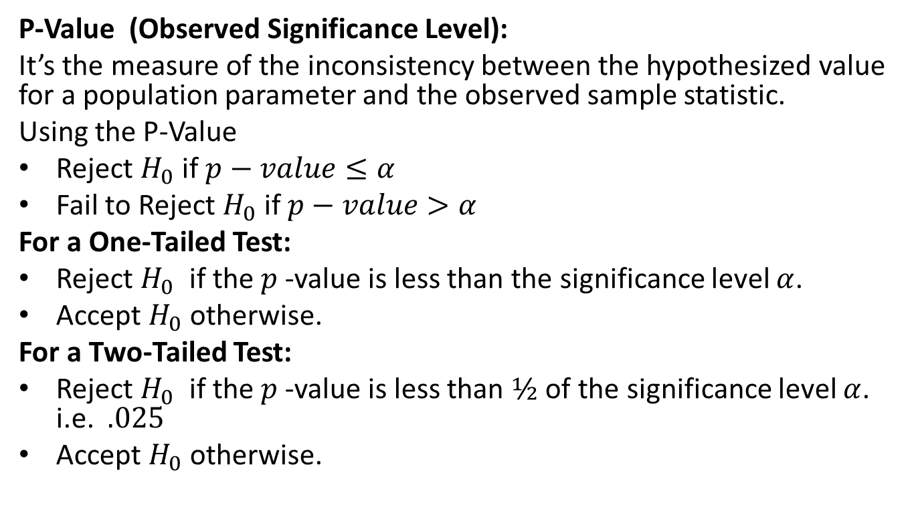
P-value (CO2)
P-Value (Observed Significance Level):
It’s the measure of the inconsistency between the hypothesized value for a population parameter and the observed sample statistic.
Using the P-Value
Reject $H_{0}$ if $p−value≤α$
Fail to Reject $H_{0}$ if $p−value>α$
For a One-Tailed Test:
Reject $H_{0}$ if the $p$-value is less than the significance level $α$.
Accept $H_{0}$ otherwise.
For a Two-Tailed Test:
Reject $H_{0}$ if the $p$-value is less than $½$ of the significance level $α$. i.e. $.025$
Accept $H_{0}$ otherwise.

Slide 45
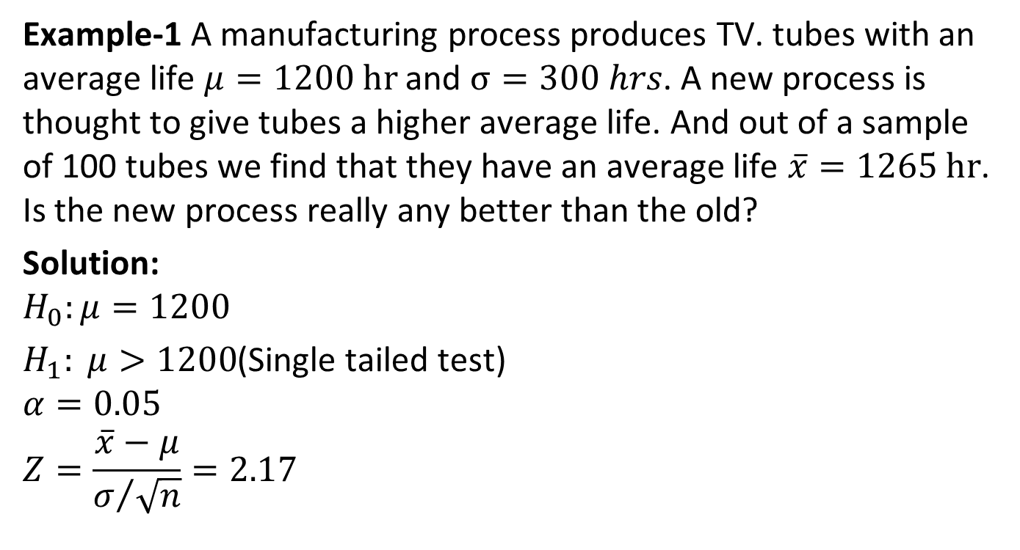
P-value (CO2)
Example-1 A manufacturing process produces TV. tubes with an average life $μ=1200 hr$ and $σ=300 hrs$. A new process is thought to give tubes a higher average life. And out of a sample of 100 tubes we find that they have an average life $\overline{x}=1265 hr$. Is the new process really any better than the old?
Solution:
$$H_{0}:μ=1200$$
$H_{1}: μ>1200$(Single tailed test)
$$α=0.05$$
$$Z=\frac{\overline{x}−μ}{σ/{\sqrt{n}}}=2.17$$

Slide 46
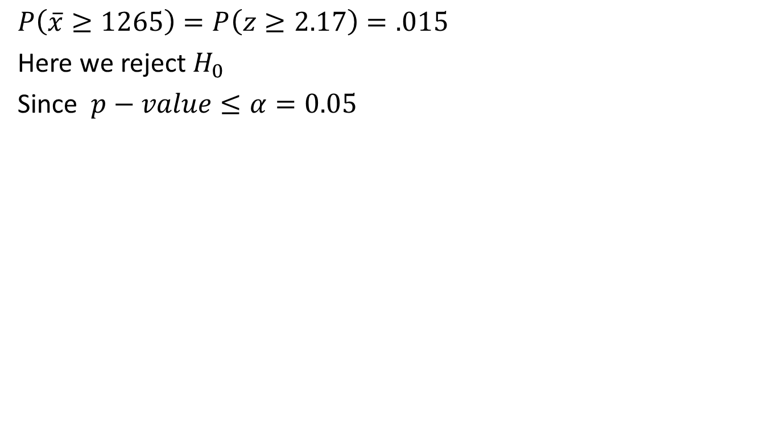
P-value (CO2)
$$P\left(\overline{x}≥1265\right)=P\left(z≥2.17\right)=.015$$
Here we reject $H_{0}$
Since $p−value≤α=0.05$

Slide 47
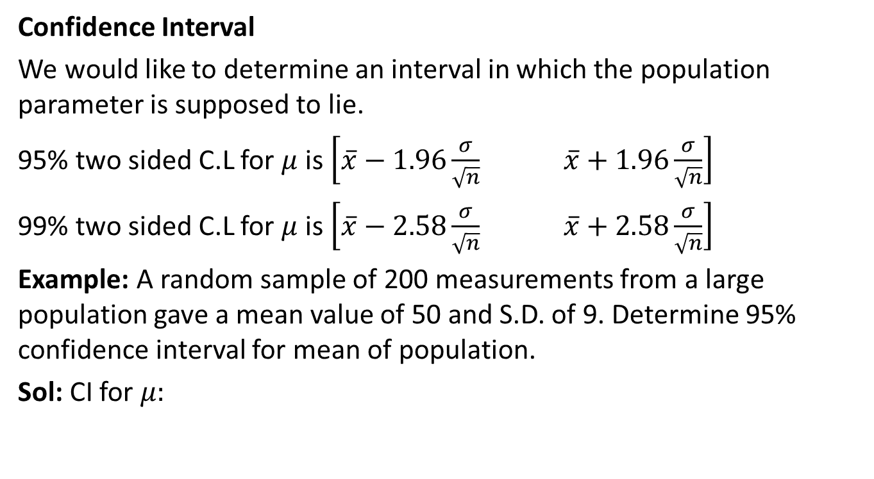
Test of Hypothesis (CO2)
Confidence Interval
We would like to determine an interval in which the population parameter is supposed to lie.
95% two sided C.L for $μ$is $\left[\overline{x}−1.96\frac{σ}{\sqrt{n}} \overline{x}+1.96\frac{σ}{\sqrt{n}}\right]$
99% two sided C.L for $μ$is $\left[\overline{x}−2.58\frac{σ}{\sqrt{n}} \overline{x}+2.58\frac{σ}{\sqrt{n}}\right]$
Example: A random sample of 200 measurements from a large population gave a mean value of 50 and S.D. of 9. Determine 95% confidence interval for mean of population.
Sol: CI for $μ:$

Slide 48
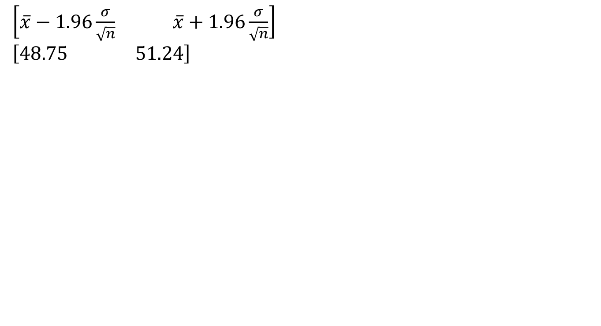
Test of Hypothesis (CO2)
$\left[\overline{x}−1.96\frac{σ}{\sqrt{n}} \overline{x}+1.96\frac{σ}{\sqrt{n}}\right]$
$$\left[48.75 51.24\right]$$

Slide 49
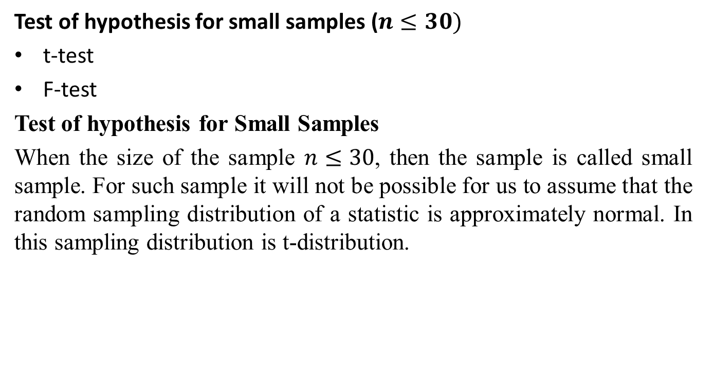
Test of Hypothesis (CO2)
Test of hypothesis for small samples ($n≤30)$
t-test
F-test
Test of hypothesis for Small Samples
When the size of the sample $n≤30$, then the sample is called small sample. For such sample it will not be possible for us to assume that the random sampling distribution of a statistic is approximately normal. In this sampling distribution is t-distribution.

Slide 50
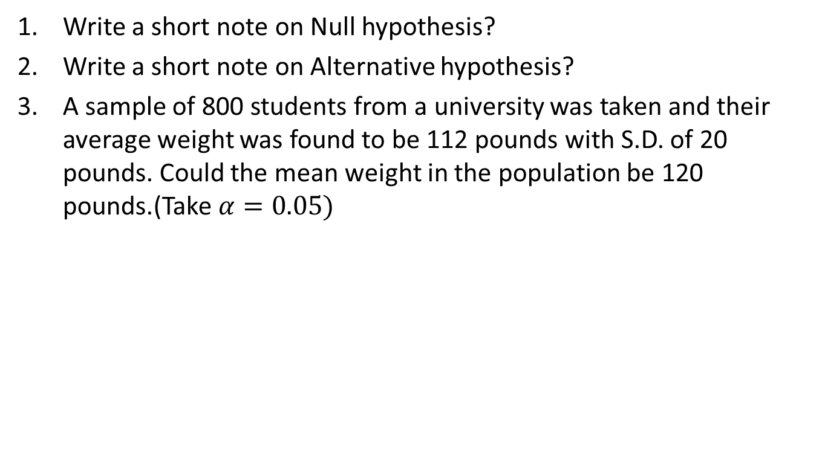
Daily Quiz(CO2)
Write a short note on Null hypothesis?
Write a short note on Alternative hypothesis?
A sample of 800 students from a university was taken and their average weight was found to be 112 pounds with S.D. of 20 pounds. Could the mean weight in the population be 120 pounds.(Take $α=0.05)$

Slide 51
Recap(CO2)
Test of hypothesis
Procedure of Test of hypothesis
Null Hypothesis
Alternate Hypothesis
Level of significance
Test of hypothesis about difference between two population mean
Test of hypothesis about Small samples

Slide 52
Topic objective (CO2)
t-Test
Explanation why a t distribution is associated with n − 1 degrees of freedom and describe the information that is conveyed by the t statistic.
Calculation the degrees of freedom for a one-sample t test and a two-independent-sample t test, and locate critical values in the t table.
Identify the assumptions for the one-sample t test.
Identify the assumptions for the two-independent-sample t test.

Slide 53
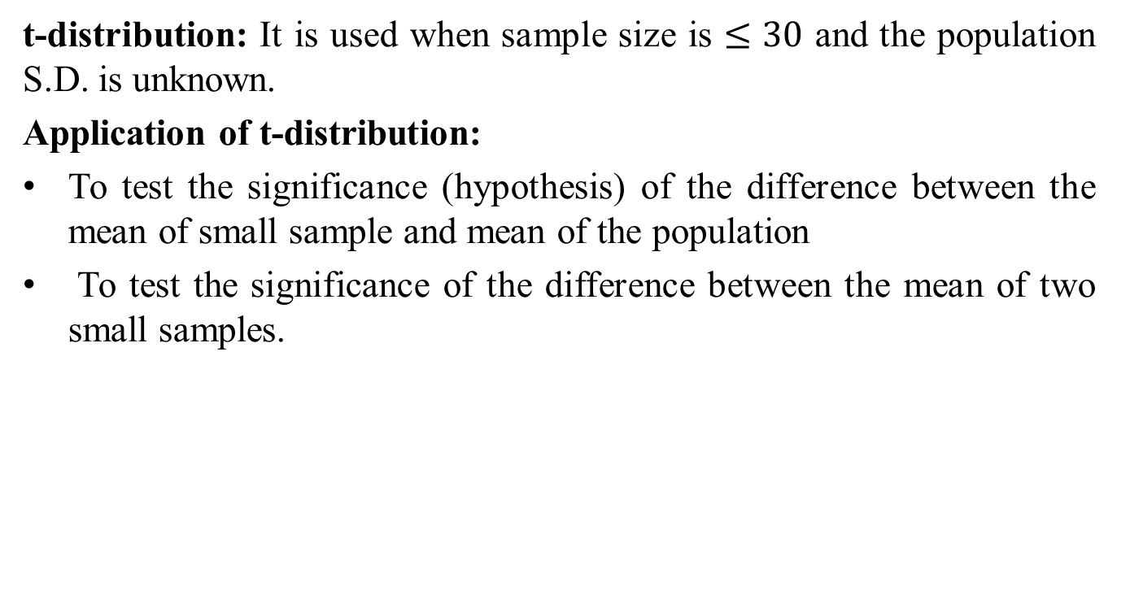
t-Test (CO2)
t-distribution: It is used when sample size is $≤30$ and the population S.D. is unknown.
Application of t-distribution:
To test the significance (hypothesis) of the difference between the mean of small sample and mean of the population
To test the significance of the difference between the mean of two small samples.

Slide 54
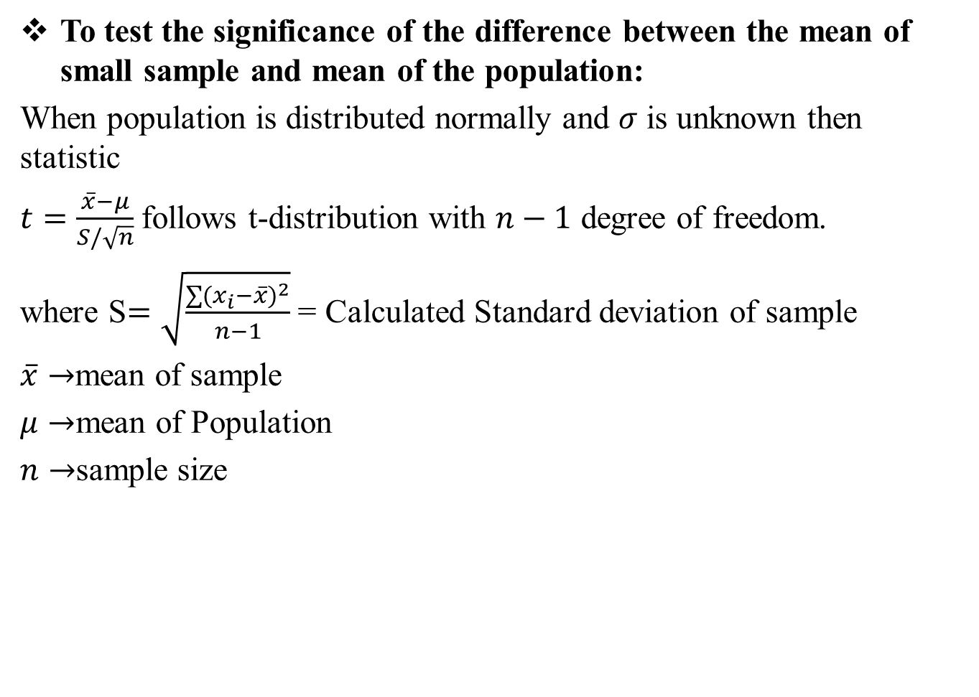
t-Test (CO2)
To test the significance of the difference between the mean of small sample and mean of the population:
When population is distributed normally and $σ$ is unknown then statistic
$t=\frac{\overline{x}−μ}{S/\sqrt{n}}$ follows t-distribution with $n−1$ degree of freedom.
where S$=\sqrt{\frac{\sum{{(x_{i}−\overline{x})}^{2}}}{n−1}}$ = Calculated Standard deviation of sample
$\overline{x}→$mean of sample
$μ→$mean of Population
$n→$sample size

Slide 55
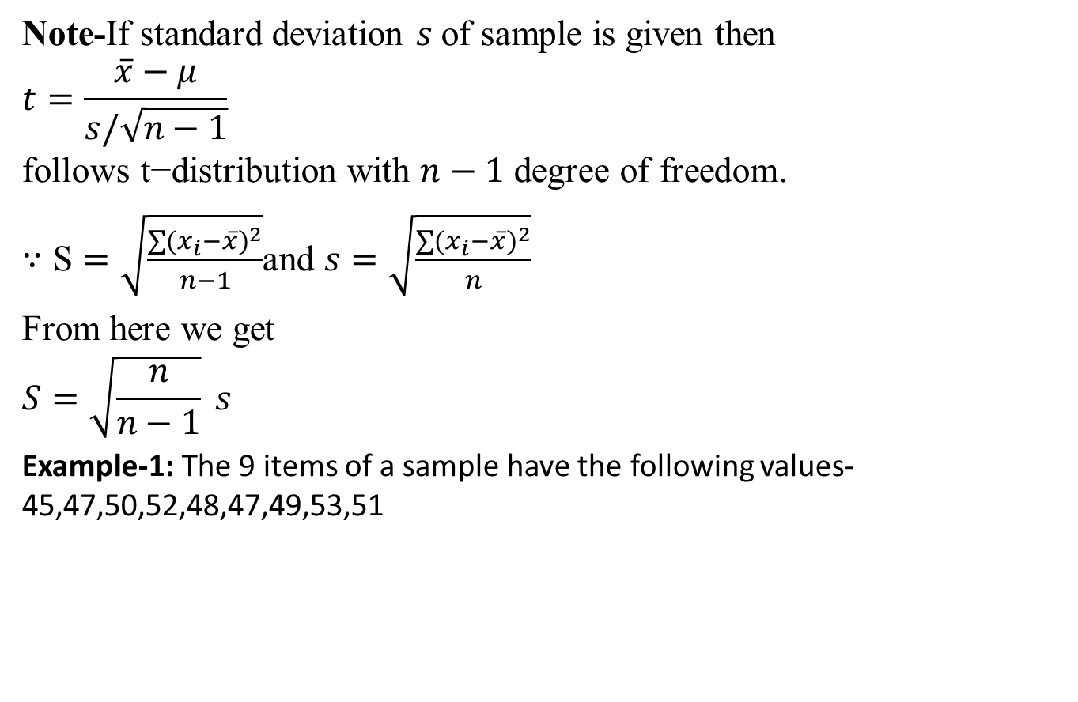
t-Test (CO2)
Note-If standard deviation $s$of sample is given then
$$t=\frac{\overline{x}−μ}{s/\sqrt{n−1}}$$
$$\text{follows} \text{t}\text{−}\text{distribution} \text{with} n−1 \text{degree} \text{of} \text{freedom}\text{.}$$
$∵\text{S}=\sqrt{\frac{\sum{{(x_{i}−\overline{x})}^{2}}}{n−1}}$and $s=\sqrt{\frac{\sum{{(x_{i}−\overline{x})}^{2}}}{n}}$
From here we get
$$S=\sqrt{\frac{n}{n−1}} s$$
Example-1: The 9 items of a sample have the following values-45,47,50,52,48,47,49,53,51

Slide 56
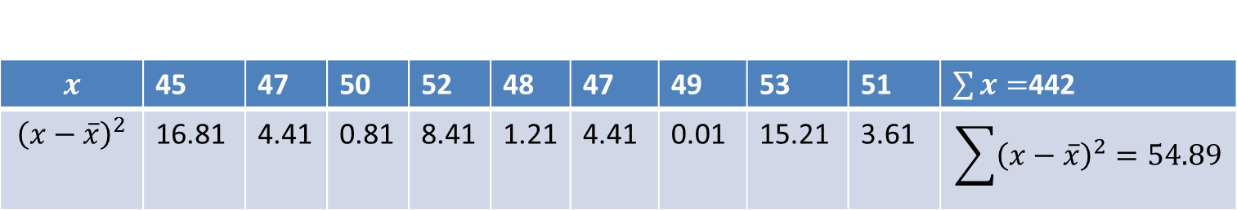
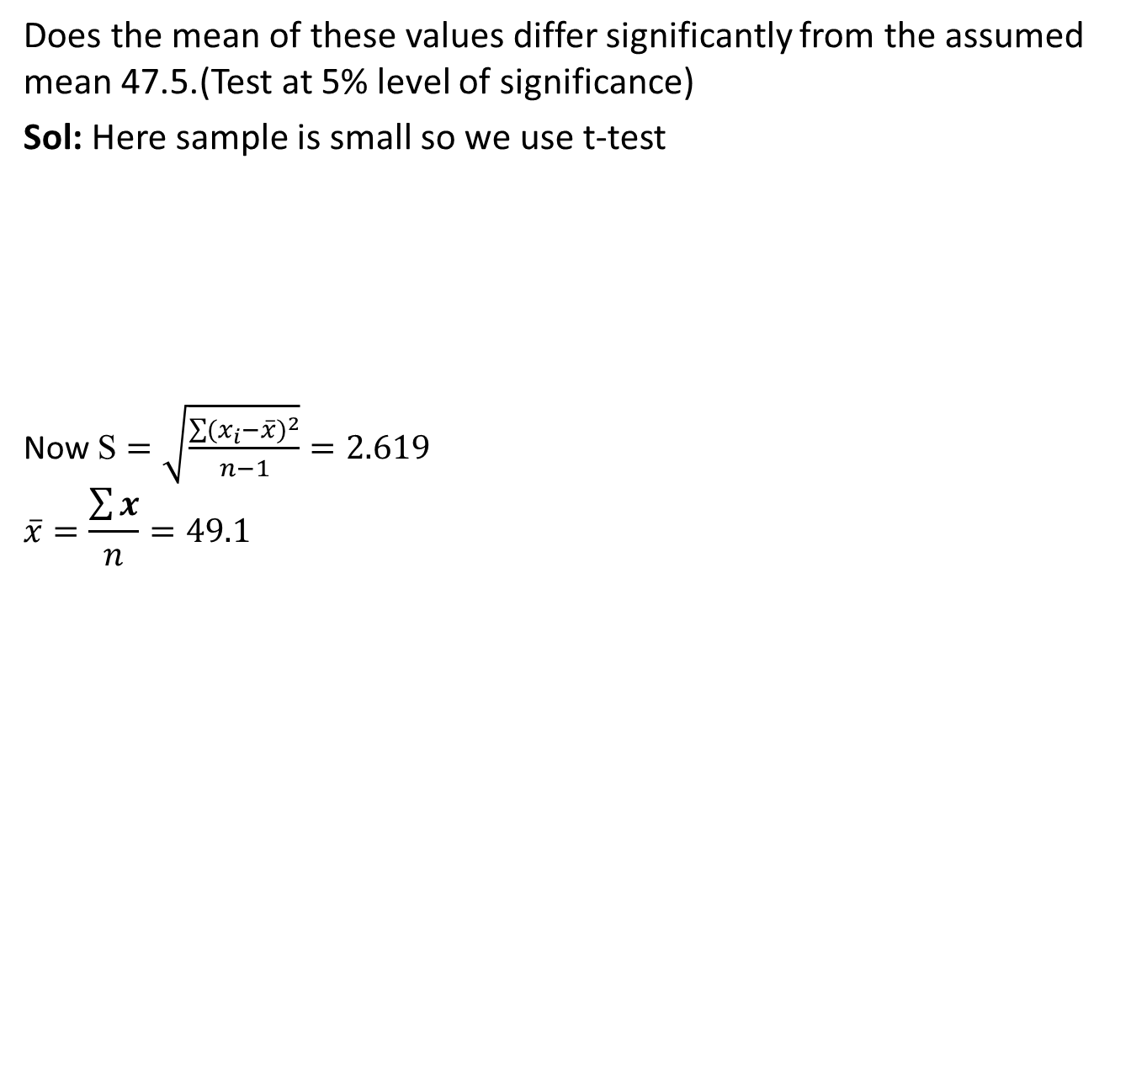
t-Test (CO2)
Does the mean of these values differ significantly from the assumed mean 47.5.(Test at 5% level of significance)
Sol: Here sample is small so we use t-test
Now $\text{S}=\sqrt{\frac{\sum{{(x_{i}−\overline{x})}^{2}}}{n−1}}=2.619$
$$\overline{x}=\frac{\sum{x}}{n}=49.1$$

Slide 57
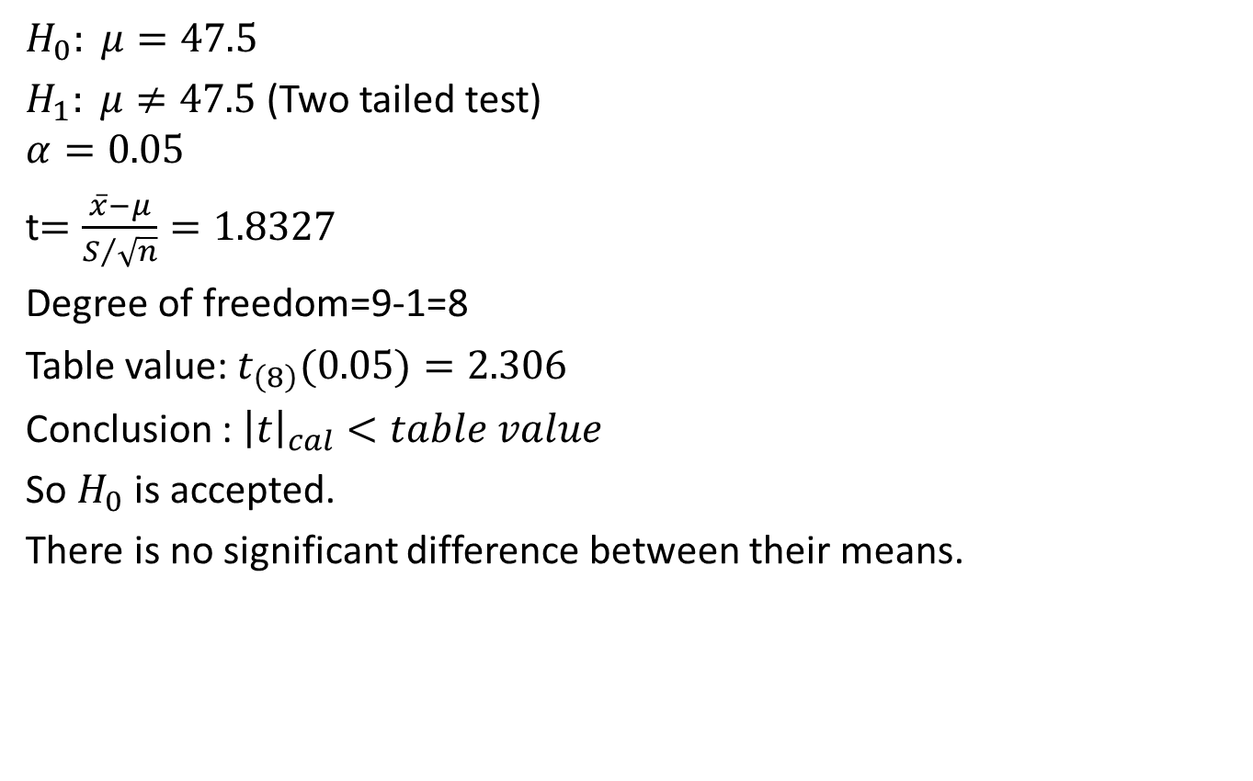
t-Test (CO2)
$$H_{0}: μ=47.5$$
$H_{1}: μ≠47.5$(Two tailed test)
$$α=0.05$$
t$=\frac{\overline{x}−μ}{S/{\sqrt{n}}}=1.8327$
Degree of freedom=9-1=8
Table value: $t_{\left(8\right)}(0.05)=2.306$
Conclusion : ${\left|t\right|}_{cal}<table value$
So $H_{0}$ is accepted.
There is no significant difference between their means.

Slide 58
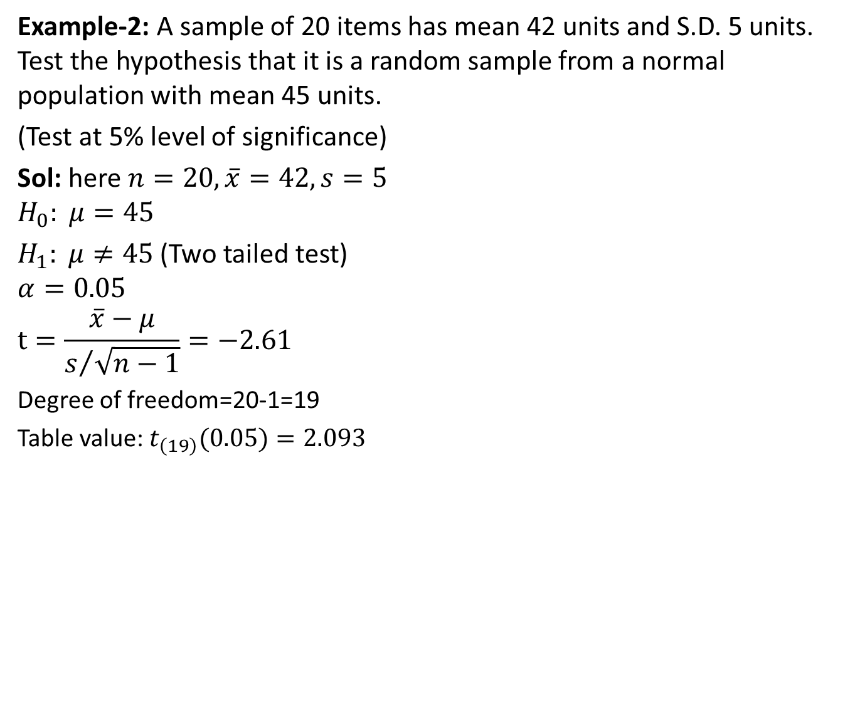
t-Test (CO2)
Example-2: A sample of 20 items has mean 42 units and S.D. 5 units. Test the hypothesis that it is a random sample from a normal population with mean 45 units.
(Test at 5% level of significance)
Sol: here $n=20, \overline{x}=42, s=5$
$$H_{0}: μ=45$$
$H_{1}: μ≠45$(Two tailed test)
$$α=0.05$$
$$t=\frac{\overline{x}−μ}{s/{\sqrt{n−1}}}=−2.61$$
Degree of freedom=20-1=19
Table value: $t_{\left(19\right)}(0.05)=2.093$

Slide 59
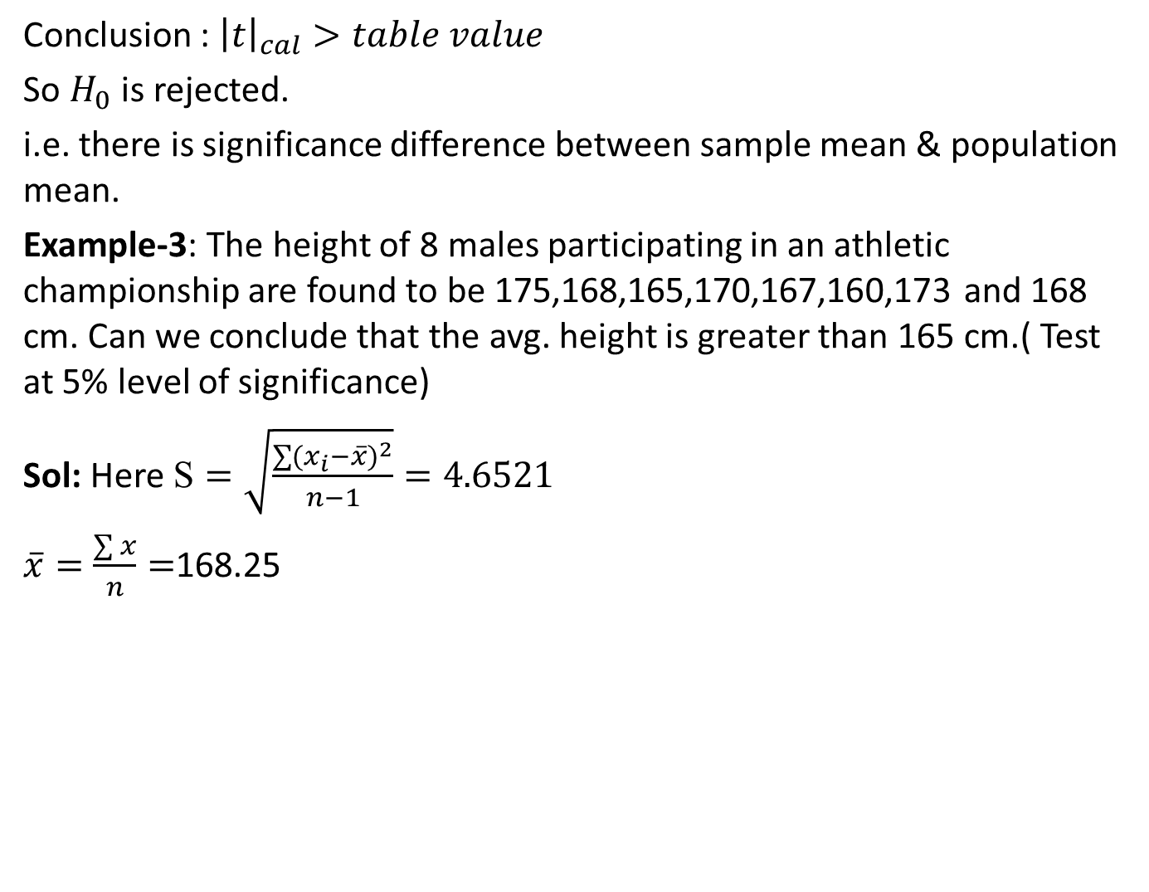
t-Test (CO2)
Conclusion : ${\left|t\right|}_{cal}>table value$
So $H_{0}$ is rejected.
i.e. there is significance difference between sample mean & population mean.
Example-3: The height of 8 males participating in an athletic championship are found to be 175,168,165,170,167,160,173 and 168 cm. Can we conclude that the avg. height is greater than 165 cm.( Test at 5% level of significance)
Sol: Here $\text{S}=\sqrt{\frac{\sum{{(x_{i}−\overline{x})}^{2}}}{n−1}}=4.6521$
$\overline{x}=\frac{\sum{x}}{n}=$168.25

Slide 60
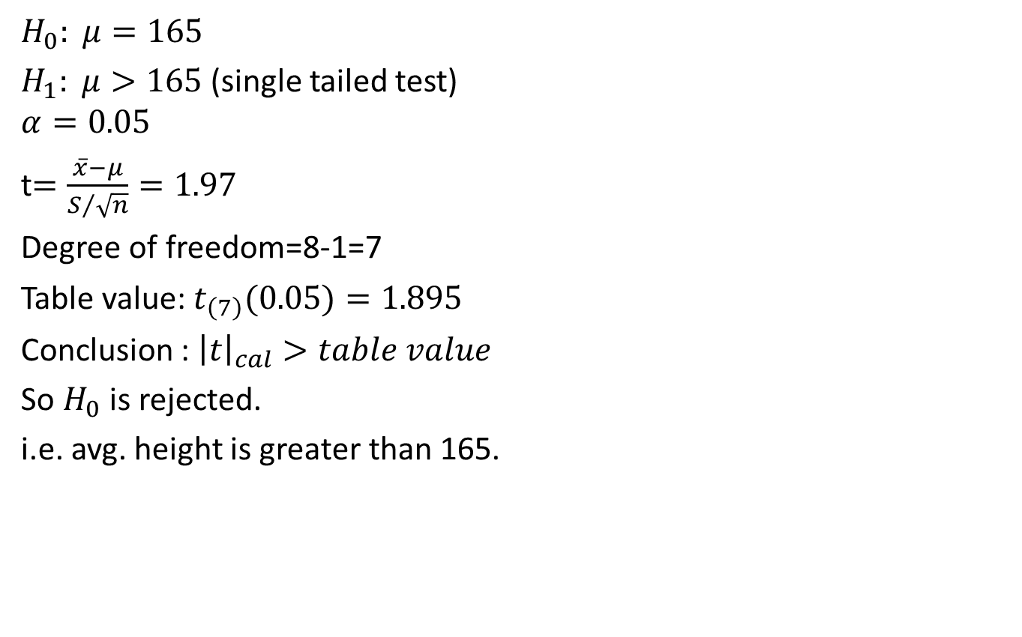
t-Test (CO2)
$$H_{0}: μ=165$$
$H_{1}: μ>165$(single tailed test)
$$α=0.05$$
t$=\frac{\overline{x}−μ}{S/{\sqrt{n}}}=1.97$
Degree of freedom=8-1=7
Table value: $t_{\left(7\right)}(0.05)=1.895$
Conclusion : ${\left|t\right|}_{cal}>table value$
So $H_{0}$ is rejected.
i.e. avg. height is greater than 165.

Slide 61
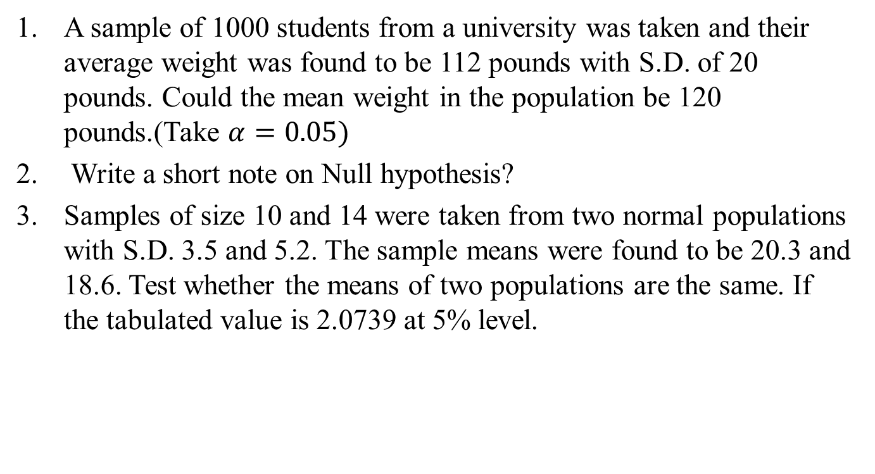
Daily Quiz(CO2)
A sample of 1000 students from a university was taken and their average weight was found to be 112 pounds with S.D. of 20 pounds. Could the mean weight in the population be 120 pounds.(Take $α=0.05)$
Write a short note on Null hypothesis?
Samples of size 10 and 14 were taken from two normal populations with S.D. 3.5 and 5.2. The sample means were found to be 20.3 and 18.6. Test whether the means of two populations are the same. If the tabulated value is 2.0739 at 5% level.

Slide 62
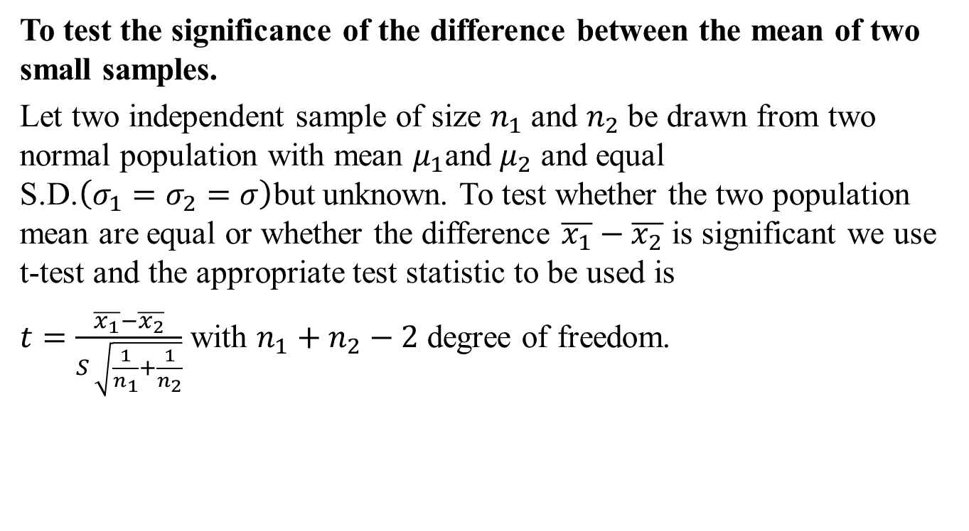
t-Test (CO2)
To test the significance of the difference between the mean of two small samples.
Let two independent sample of size $n_{1}$ and $n_{2}$ be drawn from two normal population with mean $μ_{1}$and $μ_{2}$ and equal S.D.$\left(σ_{1}=σ_{2}=σ\right)$but unknown. To test whether the two population mean are equal or whether the difference $\overline{x_{1}}−\overline{x_{2}}$ is significant we use t-test and the appropriate test statistic to be used is
$t=\frac{\overline{x_{1}}−\overline{x_{2}}}{S \sqrt{\frac{1}{n_{1}}+\frac{1}{n_{2}}}}$ with $n_{1}+n_{2}−2$ degree of freedom.

Slide 63
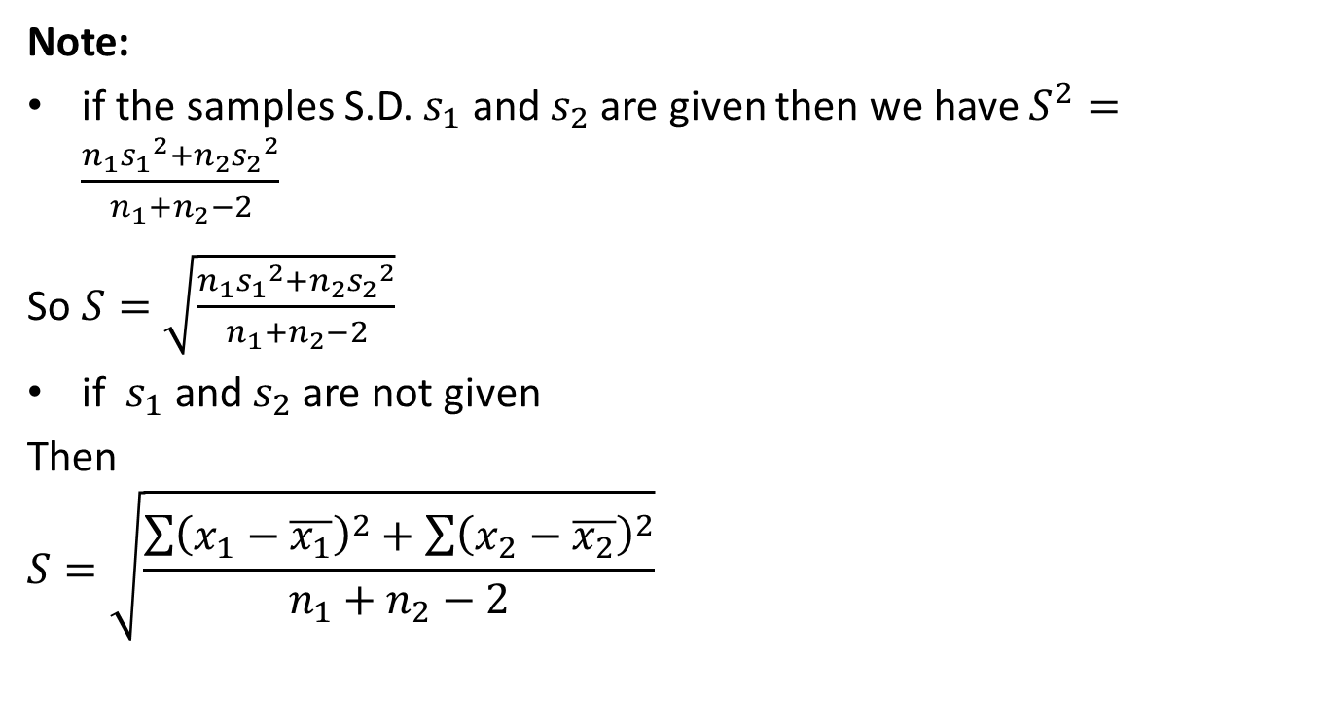
t-Test (CO2)
Note:
if the samples S.D. $s_{1}$ and $s_{2}$ are given then we have $S^{2}=\frac{n_{1}{s_{1}}_{ }^{2}+n_{2}{s_{2}}_{ }^{2}}{n_{1}+n_{2}−2}$
So $S=\sqrt{\frac{n_{1}{s_{1}}_{ }^{2}+n_{2}{s_{2}}_{ }^{2}}{n_{1}+n_{2}−2}}$
if $s_{1}$ and $s_{2}$ are not given
Then
$$S=\sqrt{\frac{\sum{{\left(x_{1}−\overline{x_{1}}\right)}^{2}}+\sum{{\left(x_{2}−\overline{x_{2}}\right)}^{2}}}{n_{1}+n_{2}−2}}$$

Slide 64
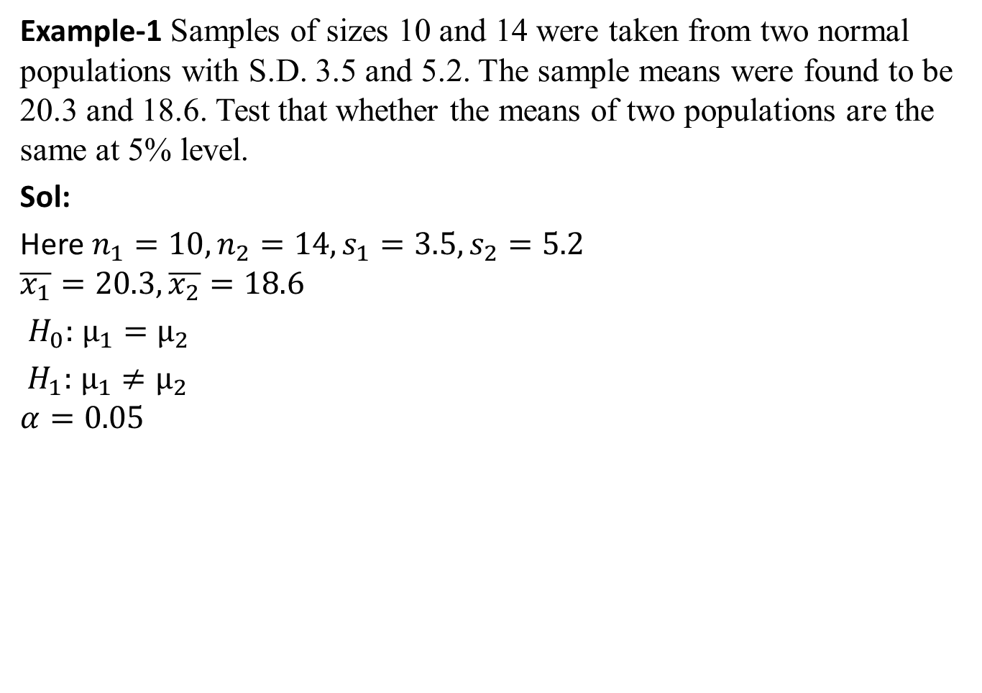
t-Test (CO2)
Example-1 Samples of sizes 10 and 14 were taken from two normal populations with S.D. 3.5 and 5.2. The sample means were found to be 20.3 and 18.6. Test that whether the means of two populations are the same at 5% level.
Sol:
Here $n_{1}=10,n_{2}=14,s_{1}=3.5,s_{2}=5.2$
$$\overline{x_{1}}=20.3,\overline{x_{2}}=18.6$$
$H_{0}:$ $μ_{1}=μ_{2}$
$H_{1}:$ $μ_{1}≠μ_{2}$
$$α=0.05$$

Slide 65
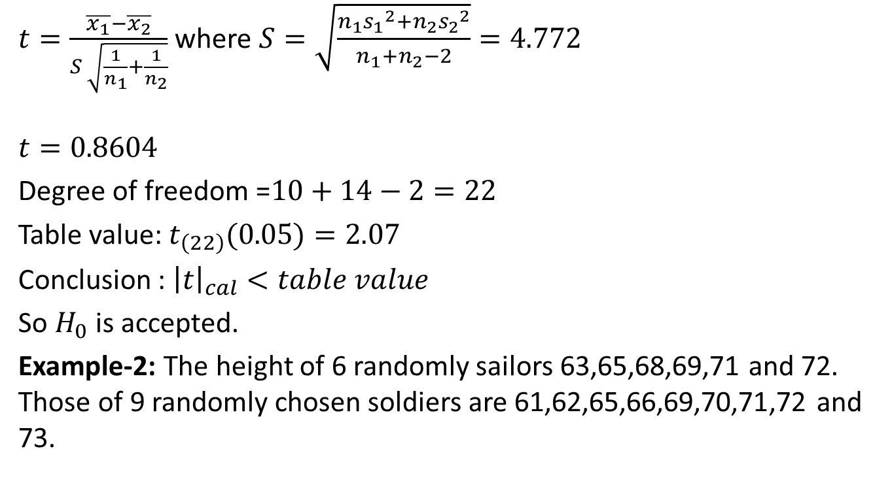
t-Test (CO2)
$t=\frac{\overline{x_{1}}−\overline{x_{2}}}{S \sqrt{\frac{1}{n_{1}}+\frac{1}{n_{2}}}}$ where $S=\sqrt{\frac{n_{1}{s_{1}}_{ }^{2}+n_{2}{s_{2}}_{ }^{2}}{n_{1}+n_{2}−2}}=4.772$
$$t=0.8604$$
Degree of freedom =$10+14−2=22$
Table value: $t_{\left(22\right)}(0.05)=2.07$
Conclusion : ${\left|t\right|}_{cal}<table value$
So $H_{0}$ is accepted.
Example-2: The height of 6 randomly sailors 63,65,68,69,71 and 72. Those of 9 randomly chosen soldiers are 61,62,65,66,69,70,71,72 and 73.

Slide 66
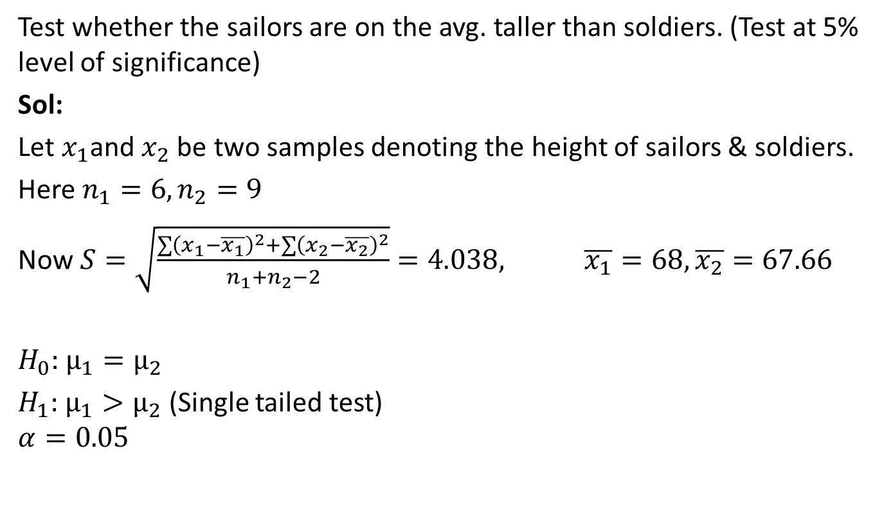
t-Test (CO2)
Test whether the sailors are on the avg. taller than soldiers. (Test at 5% level of significance)
Sol:
Let $x_{1}$and $x_{2}$ be two samples denoting the height of sailors & soldiers.
Here $n_{1}=6,n_{2}=9$
Now $S=\sqrt{\frac{\sum{{\left(x_{1}−\overline{x_{1}}\right)}^{2}}+\sum{{\left(x_{2}−\overline{x_{2}}\right)}^{2}}}{n_{1}+n_{2}−2}}=4.038, \overline{x_{1}}=68,\overline{x_{2}}=67.66$
$H_{0}:$ $μ_{1}=μ_{2}$
$H_{1}:$ $μ_{1}>μ_{2}$ (Single tailed test)
$$α=0.05$$

Slide 67
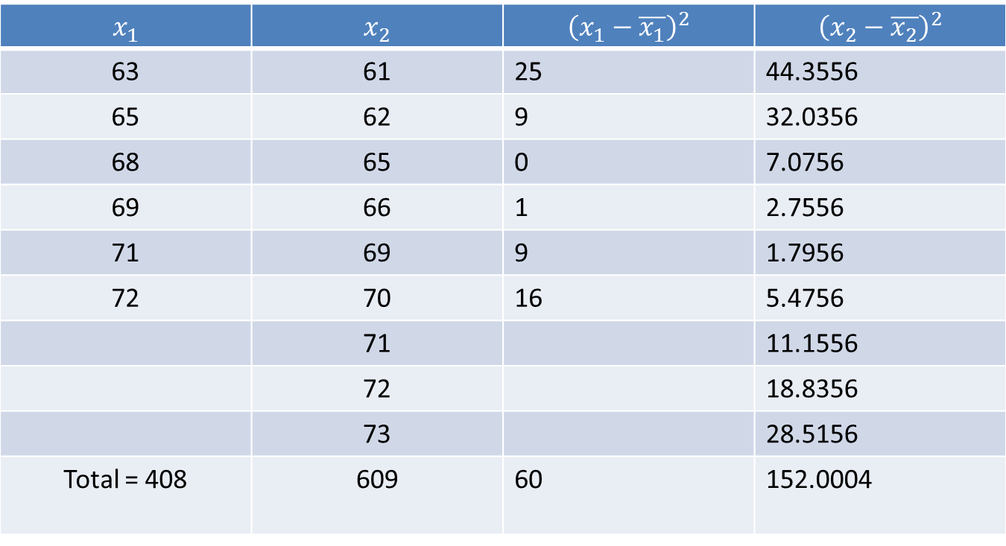
t-Test (CO2)
a

Slide 68
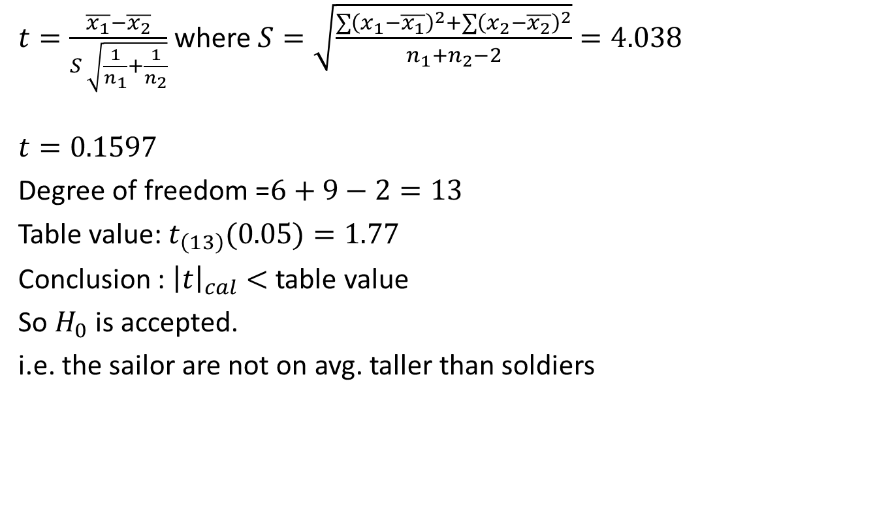
t-Test (CO2)
$t=\frac{\overline{x_{1}}−\overline{x_{2}}}{S \sqrt{\frac{1}{n_{1}}+\frac{1}{n_{2}}}}$ where$S=\sqrt{\frac{\sum{{\left(x_{1}−\overline{x_{1}}\right)}^{2}}+\sum{{\left(x_{2}−\overline{x_{2}}\right)}^{2}}}{n_{1}+n_{2}−2}}=4.038$
$$t=0.1597$$
Degree of freedom =$6+9−2=13$
Table value: $t_{\left(13\right)}(0.05)=1.77$
Conclusion : ${\left|t\right|}_{cal}<$ table value
So $H_{0}$ is accepted.
i.e. the sailor are not on avg. taller than soldiers

Slide 69
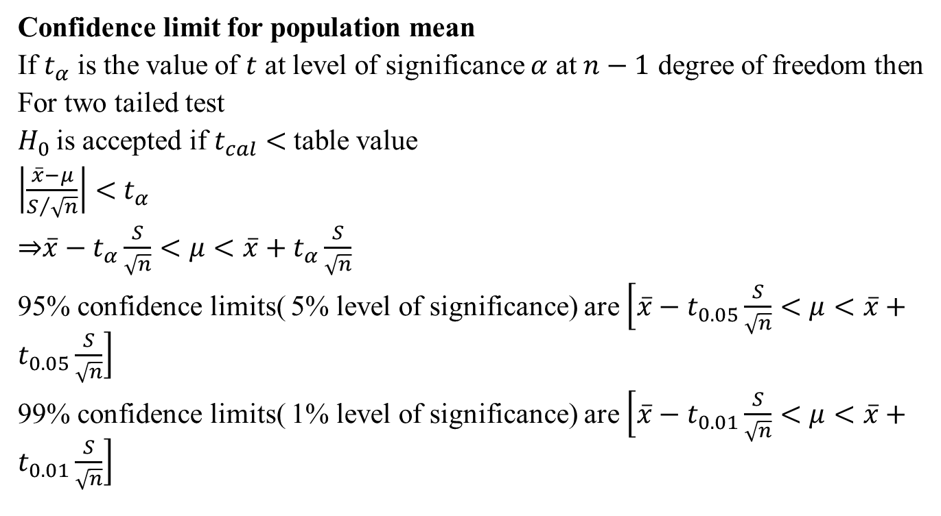
t-Test (CO2)
Confidence limit for population mean
If $t_{α}$ is the value of $t$ at level of significance $α$ at $n−1$ degree of freedom then
For two tailed test
$H_{0}$is accepted if $t_{cal}<$table value
$\left|\frac{\overline{x}−μ}{S/{\sqrt{n}}}\right|<$ $t_{α}$
⇒$\overline{x}−t_{α}\frac{S}{\sqrt{n}}<μ<\overline{x}+t_{α}\frac{S}{\sqrt{n}}$
95% confidence limits( 5% level of significance) are $\left[\overline{x}−t_{0.05}\frac{S}{\sqrt{n}}<μ<\overline{x}+t_{0.05}\frac{S}{\sqrt{n}}\right]$
99% confidence limits( 1% level of significance) are $\left[\overline{x}−t_{0.01}\frac{S}{\sqrt{n}}<μ<\overline{x}+t_{0.01}\frac{S}{\sqrt{n}}\right]$

Slide 70

t-Test (CO2)
Example: A random sample of size 16 has 53 as mean. The sum of square of deviation from mean is 150. Find the two sided 95% confidence interval for population mean.
Sol:
$n=$16, $\overline{x}=53,$ $\sum{{(x_{i}−\overline{x})}^{2}}=53$
$\text{S}=\sqrt{\frac{\sum{{(x_{i}−\overline{x})}^{2}}}{n−1}}=3.162$
Degree of freedom(df)=16-1=15
$t_{15}\left(0.05\right)=2.131$
95% confidence limits for $μ$ are $\left[\overline{x}−t_{0.05}\frac{S}{\sqrt{n}}<μ<\overline{x}+t_{0.05}\frac{S}{\sqrt{n}}\right]$
$\left[51.315 54.685\right]$

Slide 71

Daily Quiz(CO2)
Problem: Intelligent test were given to two groups of boys & girls
Mean S.D. Size
Girl 75 8 60
Boys 73 10 100
Examine if the difference between mean scores is significant? (Take $α=0.05)$
Ans: $H_{0}$ is accepted

Slide 72

Weekly Assignment(CO2)
1 Intelligent test were given to two groups of boys & girls
Mean S.D. Size
Girl 68 5 60
Boys 85 10 100
Examine if the difference between mean scores is significant? (Take $α=0.05)$
2. Define Null hypothesis for
t test
Z-test

Slide 73
Recap(CO2)
Test of hypothesis
Procedure of Test of hypothesis
Null Hypothesis
Alternate Hypothesis
Level of significance
Test of hypothesis about difference between two population mean
t-Test

Slide 74

F-Test (CO2)
Test of hypothesis for small samples ($n≤30)$
t-test
F-test
Test of hypothesis for Small Samples
When the size of the sample $n≤30$, then the sample is called small sample. For such sample it will not be possible for us to assume that the random sampling distribution of a statistic is approximately normal. In this sampling distribution is F-distribution.

Slide 75

F-Test (CO2)
F-Test: In testing the Significance difference of two means of two Samples, we assumed that the two Samples came from the Same Population or population with equal Variance. The object of the F-test is to discover whether two independent estimates of population variance differ significantly or whether the two samples may be regarded as drown from the normal populations having the same variance.
Hence before applying the t-test for the Significance of difference of two means, we have to test for the equality of population variance by using F-test.
Let $n_{1} and n_{2}$ be the Sizes of two Samples with Variances $s_{1}^{2}$ and $s_{2}^{2}$ respectively.

Slide 76

F-Test (CO2)
Case I : If $s_{1}^{2}$ & $s_{2}^{2}$ are given and $S_{1}^{2}>S_{2}^{2}$ .
Where $S_{1}^{2}=\frac{n_{1}s_{1}^{2}}{n_{1}−1} and S_{2}^{2}=\frac{n_{2}s_{2}^{2}}{n_{2}−1}$
Then Test Statistic $F=\frac{S_{1}^{2}}{S_{2}^{2}}>1$with degree of freedom is $ν_{1}=n_{1}−1$, $ν_{2}=n_{2}−1$ .
And If $S_{2}^{2}>S_{1}^{2}$ then
Test Statistic $F=\frac{S_{2}^{2}}{S_{1}^{2}}>1$ with degree of freedom is
$ν_{2}=n_{2}−1, ν_{1}=n_{1}−1$

Slide 77

F-Test (CO2)
Case II :If $s_{1}^{2}$ & $s_{2}^{2}$ are not given.
Where $s_{1}^{2}=\frac{\sum{{(x_{1}− {\overline{x}}_{1)}}^{2}}}{n_{1}−1}$ and $s_{2}^{2}=\frac{\sum{{(x_{2}− {\overline{x}}_{2})}^{2}}}{n_{2}−1}$
$x_{1}$and$x_{2}$ are two Samples.
Hence Test Statistic $F=\frac{s_{1}^{2}}{s_{2}^{2}} if s_{1}^{2}>s_{2}^{2}$ with degree of freedom is $ν_{1}=n_{1}−1$, $ν_{2}=n_{2}−1$ .
Or Test Statistic $=\frac{s_{2}^{2}}{s_{1}^{2}} if s_{2}^{2}>s_{1}^{2}$ with degree of freedom is
$ν_{2}=n_{2}−1, ν_{1}=n_{1}−1$.
Conclusion: Same as t-test.

Slide 78

F-Test (CO2)
Q1.The two random samples reveal the following data:
Test the equality of Population Variance.
Ans. For Checking the equality of Population Variance, we apply F-test.
Null Hypothesis $H_{0}:σ_{1}^{2}=σ_{2}^{2}$ i.e. there is no significant difference between the population Variances.
Alternative Hypothesis $H_{1}:σ_{1}^{2}≠σ_{2}^{2}$
Test Statistic: Since $s_{1}^{2} \&{ s}_{2}^{2}$ are given then
Sample no. | Size | Mean | Variance
I | 16 | 440 | 40
II | 25 | 460 | 42

Slide 79

F-Test (CO2)
Hence $S_{1}^{2}=\frac{n_{1}s_{1}^{2}}{n_{1}−1}=\frac{16X 40}{15}=42.7$
And $S_{2}^{2}=\frac{n_{2}s_{2}^{2}}{n_{2}−1}=\frac{25X 42}{24}$=43.75
Since $S_{2}^{2}>S_{1}^{2}$, Now $F=\frac{S_{2}^{2}}{S_{1}^{2}}=\frac{43.75}{42.7}=1.02$ with degree of freedom is $ν_{2}=n_{2}−1, ν_{1}=n_{1}−1$ i.e.
$υ_{2}=25−1=24 and υ_{1}=16−1=15$.
Conclusion: Here the calculate Value of $F=1.02<F_{(24,15)}=2.29$ at 5% level of Significance. Hence $H_{0}$ is accepted. Therefore population variances are equal.

Slide 80

F-Test (CO2)
Example-2: The height of 6 randomly sailors 63,65,68,69,71 and 72. Those of 9 randomly chosen soldiers are 61,62,65,66,69,70,71,72 and 73. Test the equality of Population Variance. (Test at 5% level of significance)
Sol:
Let $x_{1}$and $x_{2}$ be two samples denoting the height of sailors & soldiers.
Here $n_{1}=6,n_{2}=9$
Where $s_{1}^{2}=\frac{\sum{{(x_{1}− {\overline{x}}_{1)}}^{2}}}{n_{1}−1}$ and $s_{2}^{2}=\frac{\sum{{(x_{2}− {\overline{x}}_{2})}^{2}}}{n_{2}−1}$
$x_{1}$and$x_{2}$ are two Samples.

Slide 81

F-Test (CO2)
$$\overline{x_{1}}=68,\overline{x_{2}}=67.66$$
Null Hypothesis $H_{0}:σ_{1}^{2}=σ_{2}^{2}$ i.e. there is no significant difference between the population Variances.
Alternative Hypothesis $H_{1}:σ_{1}^{2}≠σ_{2}^{2}$
$$Level of significance α=0.05$$

Slide 82
F-Test (CO2)
a

Slide 83

F-Test (CO2)
$s_{1}^{2}=\frac{\sum{{(x_{1}− {\overline{x}}_{1)}}^{2}}}{n_{1}−1}=\frac{60}{5}=12$ and
$s_{2}^{2}=\frac{\sum{{(x_{2}− {\overline{x}}_{2})}^{2}}}{n_{2}−1}=\frac{152.0004}{8}=19.00005$
Test Statistic $F test=\frac{s_{2}^{2}}{s_{1}^{2}}=\frac{19.00005}{12}=1.583375$
$if s_{2}^{2}>s_{1}^{2}$ with degree of freedom is
$ν_{2}=n_{2}−1=9−1=8, ν_{1}=n_{1}−1=6−1=5$.
Table value: $F_{\left(8,5\right)}(0.05)=4.82$
Conclusion : ${\left|F\right|}_{cal}<$ table value
So $H_{0}$ is accepted.
i.e. Therefore population variances are equal.

Slide 84

Daily Quiz(CO2)
Problem: The random samples were drawn from two normal populations and the following results were obtained
Sample 1: 16,17,18,19,20,21,22,24,26,27
Sample 2: 19,22,23,25,26,28,29,30,31,32,35,36
Obtain estimates of the variances of populations and test whether the two populations have the same variances.
(Take $α=0.05$ )

Slide 85

Topic Objective (CO2)
Chi Square Test($χ^{2}$)
Distinguish between nonparametric and parametric tests.
Explanation how the test statistic is computed for a chi-square test.
Compute the chi-square goodness-of-fit test and interpret the results.
Identify the assumption and the restriction of expected frequency size for the chi-square test.
Compute the chi-square test for independence and interpret the results.

Slide 86


Chi Square Test($χ^{2}$)(CO2)
Chi Square Test($χ^{2}$)
Chi-square test of goodness of Fit.
Chi-square test of independence of Attributes.

Slide 87

Chi Square Test($χ^{2}$)(CO2)
Chi Square Test($χ^{2}$)
Chi Square test is the test of significance.
Chi square test is a useful measures of comparing experimentally obtained result with those expected theoretically and based on hypothesis.
$χ^{2}=\sum{\frac{{\left(Observed−Expected\right)}^{2}}{Expected}}$
It is a mathematical expression, representing the ratio of experimentally obtained result(O) and theoretically expected result(E) based on certain hypothesis. It uses data in form of frequencies.

Slide 88

Chi Square Test($χ^{2}$)(CO2)
Chi square test is calculated by dividing the square of overall deviation in the observed and expected frequencies by expected frequency. $χ^{2}=\sum{\frac{{\left(O−E\right)}^{2}}{E}}$
O=the frequencies observed, E=the frequencies expected$,Σ$= sum of
If there is no difference between actual and observed frequencies, the value of Chi- Square is zero.
If there is difference between actual and observed frequencies, the value of Chi- Square would be more than zero.
But the difference in the observed frequencies, may also be due to the sampling fluctuations and it should be ignored in drawing interference.

Slide 89
Chi Square Test($χ^{2}$)(CO2)
Degree of Freedom
In test, while comparing the calculated value with the table value, we have to calculate the degree of freedom. The degree of freedom is calculated from the no of classes. Therefore, the no. of degree of freedom in a test is equal to the no. of classes minus one.
If there are two classes, three classes and four classes, the degree of freedom would be 2-1,3-1 and 4-1, respectively. In a contingency table, the degree of freedom is calculated in different manner:
d.f.=(r-1)(c-1)
Where r= no. of row in the table,C= no. of column in the table
Thus in 2×2 contingency table, the degree of freedom is (2-1)(2-1)=1. Similarly, in a 3×3 contingency table, the degree of freedom is

Slide 90

Chi Square Test($χ^{2}$)(CO2)
(3-1)(3-1)=4. :Likewise in 3×4 contingency table degree of freedom is (3-1)(4-1)=6, and so on.
Example:2 Rows × 2 columns
Degree of freedom = (r-1)(c-1)=(2-1)(2-1)=1

Slide 91
Chi Square Test($χ^{2}$)(CO2)
Application of chi square test
The chi square are applicable in varied problems in agriculture, biology engineering and medical sciences.
To test the goodness of fit.
To test the independence of attributes.
To test the detection of linkage.
To test the homogeneity of independent estimates of the population variance.

Slide 92

Chi Square Test($χ^{2}$)(CO2)
Example: The demand for a particular spare part in a factory was found to vary from day-to-day. In a sample study the following information was obtained:
Under the null hypothesis, the expected frequencies of the spare part demanded on each of the six days would be:(1124+1125+1110+1120+1126+1115)/6=6270/6=1120

Slide 93

Chi Square Test($χ^{2}$)(CO2)

Slide 94

Chi Square Test($χ^{2}$)(CO2)
$χ^{2}=\sum_{i=1}^{n}{\frac{{\left(Observed−Expected\right)}^{2}}{Expected}}$=0.179
The number of degrees of freedom = 6 –1 = 5 (since we are given 6 frequencies subjected to only one linear constraint: ∑$O_{i}$=∑$E_{i}$=6720). The tabulated ${χ^{2}}_{0.05}^{ }$for 5 d.f.= 11.07
Conclusion: Since calculated value of $χ^{2}$is less than the tabulated value, it is not significant and the null hypothesis may accepted at 5% level of significance. Hence we conclude that the numbers of parts demanded are same over the 6-day period.

Slide 95

Chi Square Test($χ^{2}$)(CO2)
Chi square test of Independent of Attributes:
Let us consider two attributes A and B divides into r classes $A_{1,}A_{2},A_{3}…A_{r}$and B divided into s classes $B_{1,}B_{2},B_{3}…B_{s}.$
Such a classification in which attributes are divided into more than two classes is known as manifold classification.
$$χ^{2}=\sum_{i=1}^{r}{\sum_{j=1}^{s}{\frac{[{\left(A_{i}B_{j}\right)−{\left(A_{i}B_{j}\right)}_{o}^{ }]}^{2}}{{\left(A_{i}B_{j}\right)}_{o}^{ }}}\text{=}}\sum_{i=1}^{r}{\sum_{j=1}^{s}{\frac{[{O_{ij}−E_{ij}]}^{2}}{E_{ij}}}}$$

Slide 96

Chi Square Test($χ^{2}$)(CO2)
Where $O_{ij}$=$A_{i}B_{j}$: observed frequency for contingency table category in column i and row j.
$E_{ij}$=${\left(A_{i}B_{j}\right)}_{o}^{ }$: expected frequency for contingency table category in column i and row j.
${\left(A_{i}B_{j}\right)}_{o}^{ }$=$\frac{{(A)}_{i}{(B)}_{j}}{N}$, (i=1,2,3…r,j=1,2,3…s)
Which is distributed as a $χ^{2}$with (r-1)(s-1) d.f.
Example :Two sample polls of votes for two candidates A and B for public office are taken, one from among the resident area of ruler areas. The results are given in the following table. Examine whether the nature of area related to the voting preference in elections.

Slide 97


Chi Square Test($χ^{2}$)(CO2)
Solution : $H_{0}:$ the nature of the area is independent of the voting preference in the election
Expected frequencies
E(620)=$\frac{1170×1000}{2000}=585$
E(380)=$\frac{830×1000}{2000}=415$
E(550)=$\frac{1170×1000}{2000}=585$

Slide 98

Chi Square Test($χ^{2}$)(CO2)
E(450)=$\frac{830×1000}{2000}=415$
Calculate the statistic $χ^{2}$
=$\frac{{(620−585)}^{2}}{585}$+$\frac{{(380−415)}^{2}}{415}$+$\frac{{(550−585)}^{2}}{585}$+$\frac{{(450−415)}^{2}}{415}$
=10.0891
The tabulated ${χ^{2}}_{0.05}^{ }$for (2-1)(2-1) d.f.= 3.841
Conclusion: since calculate $χ^{2}$is much greater than the tabulated value, it is highly significant and null hypothesis is rejected at 5% of level of significance. Thue we conclude that nature of area is rejected to voting preference in the election.

Slide 99


Chi Square Test($χ^{2}$)(CO2)
Example : What are the expected frequencies of the contingency tables given below:
Observed frequency:
Expected frequency:

Slide 100


Chi Square Test($χ^{2}$)(CO2)
Example :To test the effectiveness of inoculation against cholera, the following table was obtained:
( figures represent the number of persons.)
Use $χ^{2}$ test to defend or refute the statement that the inoculation prevents attack from cholera.
Solution : $H_{0}:$the inoculation does not prevents attack from cholera.

Slide 101



Chi Square Test($χ^{2}$)(CO2)
Expected frequencies
Calculate the statistic $χ^{2}$

Slide 102

Chi Square Test($χ^{2}$)(CO2)
${χ^{2}}_{cal}^{ }$= $\sum{\frac{{\left(Oi−Ei\right)}^{2}}{Ei}}$ =4.8863
The tabulated ${χ^{2}}_{0.05}^{ }$for (2-1)(2-1) d.f.= 3.841
Conclusion: since calculate $χ^{2}$is much greater than the tabulated value, it is highly significant and null hypothesis is rejected at 5% of level of significance. Hence we defend the statement that inoculation prevents attack from cholera.

Slide 103
Daily Quiz(CO2)
Q1: A sample analysis of examination results of 500 students it was found that 220 students have failed, 170 have secured a third class, 90 have secured a second class and the rest, a first class. Do these figures support the general belief that above categories are in the ratio 4:3:2:1 respectively?(Test at 5 % level of significance)
Q2: A sample of 400 students of under graduate and 400 students of post graduate classes was taken to know their opinion about autonomous colleges.290 of the under graduate and 310 of the post graduate students favored the autonomous status. Present these facts in the form of a table and test at 5% level that the opinion regarding autonomous status of colleges is independent of the level of classes of students.

Slide 104

Recap(CO2)
Test of hypothesis
Test of hypothesis about difference between two population mean
To test the significance of the difference between the mean of two small samples.
$χ^{2}$ test

Slide 105
Topic objective (CO2)
Analysis of variance(ANOVA)
Appropriately interpret results of analysis of variance tests.
Distinguish between one and two factor analysis of variance tests.
Identify the appropriate hypothesis testing procedure based on type of outcome variable and number of samples.

Slide 106

Analysis of Variance (ANOVA)(CO2)
ANOVA:
ANOVA is used to determine there is any significant difference between the mean of three or more independent samples.
ANOVA is carried out on the basis of ratio between two variances, this ratio forms the test statistic known as $F$-statistics given by-
$$F=\frac{variance between the samples}{variance with in the sample}$$

Slide 107
Analysis of Variance (ANOVA)(CO2)
ANOVA is to split up the total variation as follows:
Variance between samples.
Variance within samples.
ANOVA classification
One way ANOVA: This is used to see the effect of an independent variable on a given dependent variable.
Two way ANOVA: This is used to see the effect of two independent variable on a given dependent variable.

Slide 108


Analysis of Variance (ANOVA)(CO2)
ANOVA TABLE:
Computation of test statistic
F =$\frac{variance between the samples}{\text{variance} \text{within} \text{the} \text{samples} }=\frac{\text{M}\text{SC}}{\text{MSE} }$

Slide 109

Analysis of Variance (ANOVA)(CO2)
Q.1 It Is desired to compare three Hospitals with regards to number of deaths per month. A sample of death records of each hospital and the number of deaths was given below. From these data suggest a difference in the no. of the deaths per month among three hospitals.

Slide 110

Analysis of Variance (ANOVA)(CO2)
Sol.Null hypothesis $H_{0 }$:There is no difference in the no. of deaths per months among three hospitals.
Alternate hypothesis $H_{1}$:There is a significant difference in the no. of death per month among three hospitals.
Level of Significance : We use 5% level of Significance.
Test Statistic : To find the Variance ratio F, we set up an ANOVA tables as follows:
Sample totals:
∑$y_{a}=3+4+3+5+0=15$
$∑y_{b}=6+3+3+4+4=20$
$∑y_{c}=7+3+4+6+5=25$

Slide 111

Analysis of Variance (ANOVA)(CO2)
Grand total(T)=$∑y_{a}$+$∑y_{b}+∑y_{c}$=60
Correction factor(C.F)=$\frac{{\left(T\right)}^{2}}{n}$=$\frac{{60}^{2}}{15}=$240
Sum of Squares of Samples:
$∑{y^{2}}_{A}$=$3^{2}$+$4^{2}$+$3^{2}$+$5^{2}$+$0^{2}$=59
$∑{y^{2}}_{B}$=$6^{2}$+$3^{2}$+$3^{2}$+$4^{2}$+$4^{2}$=86
$∑{y^{2}}_{C}$=$7^{2}$+$3^{2}$+$4^{2}$+$6^{2}$+$5^{2}$=135
Total Sum of Squares= $∑{y^{2}}_{A}$+$∑{y^{2}}_{B}$+$∑{y^{2 }}_{C}$ - C.F
=59+86+135-240=40

Slide 112

Analysis of Variance (ANOVA)(CO2)
Sum of Squares between Samples
=$\frac{ \left(∑y_{A}\right) ^{2}}{n_{1}}+\frac{ \left(∑y_{B}\right) ^{2}}{n_{2}}+\frac{ \left(∑y_{C}\right) ^{2}}{n_{3}}−\frac{ \left(T\right) ^{2}}{n}$
=$\frac{ \left(15\right) ^{2}}{5}+\frac{ \left(20\right) ^{2}}{5}+\frac{ \left(25\right) ^{2}}{5}−240$
= 10
Sum of squares with in the samples
= Total sum of squares – sum of squares between the samples
= 40-10
=30

Slide 113

Analysis of Variance (ANOVA)(CO2)
Degree of freedom for total sum of squares =n-1=15-1=14
Degree of freedom for Hospitals=c-1 = 3-1=2
Degree of freedom for Error =n-c =15-3=12
ANOVA TABLE

Slide 114

Analysis of Variance (ANOVA)(CO2)
The tabular value of F at 5 % level of significance with degree of freedom $ν_{1}$=2 & $ν_{2}=12 is 3.89$:
Conclusion: $F_{cal}<F_{tab},$i. e. $H_{0 }$ is accepted, so the difference is insignificant and we conclude that the data do not suggest a difference in the no of deaths per month among the three hospitals.

Slide 115

Analysis of Variance (ANOVA)(CO2)
Q.2 A manufacturing company purchased three new machines of different makes and wishes to determine whether one of them is faster than the others in producing a certain out put . Five hourly production figures are observed at random from each machine and the results are given below:

Slide 116

Analysis of Variance (ANOVA)(CO2)
Use ANOVA and determine whether the machines are significantly
Different in their mean speed.(Given at 5% level,F2,12=3.89)
Sol. Null hypothesis H0: Machines are not significantly different in their mean speed i.e.,$μ1=μ2=μ3$.
Alternate hypothesis $H_{1}$:Machines are significantly different in their mean speed.
Level of Significance: We use 5% level of Significance.
Test Statistic: T o find the Variance ratio F, we set up an ANOVA tables as follows: let us shift the origin at 30 i.e., reduce each observations by 30.we have

Slide 117


Analysis of Variance (ANOVA)(CO2)
Sample totals:
∑$A_{1}=−5+0+6+8+1=1$0
$∑A_{2}=1+9+8+12+5=$35
$∑A_{3}=−6+0−2−5−2=−15$

Slide 118

Analysis of Variance (ANOVA)(CO2)
1. Grand total(T)=$∑A_{1}$+$∑A_{2}+∑A_{3}$=30
2. Correction factor(C.F)=$\frac{{\left(T\right)}^{2}}{n}$=$\frac{{(30)}^{2}}{15}=6$0
Sum of Squares of Samples:
$∑{A^{2}}_{1}$=${(−5)}^{2}$+0+$6^{2}$+$8^{2}$+$1^{2}$=126
$∑{A^{2}}_{2}$=$1^{2}$+$9^{2}$+$8^{2}$+${12}^{2}$+$5^{2}$=315 $∑{A^{2}}_{3}$=${(−6)}^{2}$+$0^{2}$+${(−2)}^{2}$+${(−5)}^{2}$+${(−2)}^{2}$=69
3. Total Sum of Squares= $∑{A^{2}}_{1}$+$∑{A^{2}}_{2}$+$∑{A^{2 }}_{3}$ - C.F
=126+315+69-60=450

Slide 119

Analysis of Variance (ANOVA)(CO2)
Sum of Squares between Samples
=$\frac{ \left(∑A_{1}\right) ^{2}}{n_{1}}+\frac{ \left(∑A_{2}\right) ^{2}}{n_{2}}+\frac{ \left(∑A_{3}\right) ^{2}}{n_{3}}−\frac{ \left(T\right) ^{2}}{n}$
=$\frac{ \left(10\right) ^{2}}{5}+\frac{ \left(35\right) ^{2}}{5}+\frac{ \left(−15\right) ^{2}}{5}−60$
= 250
Sum of squares with in the samples
= Total sum of squares – sum of squares between the samples
= 450-250
=200
Degree of freedom for total sum of squares =n-1=15-1=14
Degree of freedom for Machines=c-1 = 3-1=2

Slide 120

Analysis of Variance (ANOVA)(CO2)
Degree of freedom for Error =n-c =15-3=12
ANOVA TABLE

Slide 121

Analysis of Variance (ANOVA)(CO2)
The tabular value of F at 5 % level of significance with degree of freedom $ν_{1}$=2 & $ν_{2}=12 is 3.89$(given)
Conclusion: $F_{cal}>F_{tab},$ so the null hypothesis is rejected and the difference is significant and we conclude that there is significant difference in the mean speed of the machines.

Slide 122

Two way ANOVA(CO2)
In two way classification, the data are classified according to two factor for example- the production of a manufacturing process can be studied on the basis of workers as well as machines. In two way classification the following procedure is adopted in the analysis of variance-
B A | $$B_{1}$$ | $$B_{2}$$ | $$⋯⋯$$ | $$B_{h}$$ | Total
$$A_{1}$$ | $$X_{11}$$ | $$X_{12}$$ | $$⋯⋯$$ | $$X_{1h}$$ | $$R_{1}$$
$$A_{2}$$ | $$X_{21}$$ | $$X_{22}$$ | $$⋯⋯$$ | $$X_{2h}$$ | $$R_{2}$$
$$⋮$$ $$⋮$$ | $$⋮$$ $$⋮$$ | $$⋮$$ $$⋮$$ | $$⋮$$ $$⋮$$ | $$⋮$$ $$⋮$$ | $$⋮$$ $$⋮$$
$$A_{k}$$ | $$X_{k1}$$ | $$X_{k2}$$ | $$⋯⋯$$ | $$X_{kh}$$ | $$R_{k}$$
Total | $$C_{1}$$ | $$C_{2}$$ | $$⋯⋯$$ | $$C_{h}$$

Slide 123

Two way ANOVA(CO2)
$H_{0}:$ $μ_{A_{1}}=μ_{A_{2}}=⋯⋯=μ_{A_{k}}$and $μ_{B_{1}}=μ_{B_{2}}=⋯⋯=μ_{B_{k}}$
$H_{1}:$ $μ_{A_{1}}≠μ_{A_{2}}≠⋯⋯=μ_{A_{k}}$and $μ_{B_{1}}≠μ_{B_{2}}≠⋯⋯≠μ_{B_{k}}$
Compute grand total of all observations i.e.
$G=\sum_{i}{\sum_{j}{X_{ij}}}$
Correction factor $\left(C.F.\right)=\frac{G^{2}}{n}$ where $n$ is total no. of items in all observations.
Compute raw sum of square $RSS=\sum_{i}{\sum_{j}{X_{ij}^{2}}}$
Total sum of square, $SST=RSS−C.F.$
Sum of square between rows,
$SSR=\frac{R_{1}^{2}+R_{2}^{2}+⋯⋯+R_{k}^{2}}{h}−C.F.$
here $h$ is no. of item in each row.

Slide 124


Two way ANOVA(CO2)
Sum of square between column,
$SSC=\frac{C_{1}^{2}+C_{2}^{2}+⋯⋯+C_{h}^{2}}{k}−C.F.$
here $k$ is no. of item in each column.
Sum of square of the error, $SSE=SST−SSR−SSC$

Slide 125


Two way ANOVA(CO2)
ANOVA Table:
If $F_{cal}<table value$ we accept Null Hypothesis $H_{0}$.
If $F_{cal}>table value$ we reject Null Hypothesis $H_{0}$.
Source of variation | Sum of squares | Degree of freedom | Mean sum of squares | $F$-ratio
Between rows | $$SSR$$ | $$k−1$$ | $$MSSR=\frac{SSR}{k−1 }$$ | $$F_{R}=\frac{MSSR}{MSSE}$$ $$F_{C}=\frac{MSSC}{MSSE}$$
Between column | $$SSC$$ | $$h−1$$ | $$MSSC=\frac{SSW}{h−\text{1} }$$
Error | $$SSE$$ | $$\left(k−1\right)\left(h−1 \right)$$ | $$MSSE=\frac{SSE}{\left(k−1\right)\left(h−1 \right)}$$

Slide 126

Two way ANOVA(CO2)
Example-1: The following table represent the no. of units of a commodity produced by 3 different workers using 3 different machines-
Test-(i) whether the mean productivity is the same for the different machines types.
(ii) Whether the three workers differ with regard to mean productivity.
Workers Machines | $$A$$ | $$B$$ | $$C$$
$$X$$ | 16 | 64 | 40
$$Y$$ | 56 | 72 | 56
$$Z$$ | 12 | 56 | 28

Slide 127

Two way ANOVA(CO2)
$H_{0}:$ $μ_{A}=μ_{B}=μ_{C}$ & $μ_{X}=μ_{Y}=μ_{Z}$
$H_{1}:$ $μ_{A}≠μ_{B}≠μ_{C}$ & $μ_{X}≠μ_{Y}≠μ_{Z}$
Compute grand total of all observations ,$G=\sum_{i}{\sum_{j}{X_{ij}=400}}$
Correction factor $\left(C.F.\right)=\frac{G^{2}}{n}=17777.78$
Compute raw sum of square $RSS=\sum_{i}{\sum_{j}{X_{ij}^{2}}=21472}$
Total sum of square, $SST=RSS−C.F.=3694.22$
Sum of square between rows,
$SSR=\frac{R_{1}^{2}+R_{2}^{2}+⋯⋯+R_{k}^{2}}{h}−C.F.=1379.55$
Sum of square between column,
$SSC=\frac{C_{1}^{2}+C_{2}^{2}+⋯⋯+C_{h}^{2}}{k}−C.F.=1987.55$
Sum of square of the error, $SSE=SST−SSR−SSC=81.78$

Slide 128


Two way ANOVA(CO2)
ANOVA Table:
Here $F_{R}>F_{\left(2,4\right)}\left(0.05\right)=6.94 \&{ F}_{C}>F_{\left(2,4\right)}\left(0.05\right)=6.94$
We reject $H_{0}.$
Source of variation | Sum of squares | Degree of freedom | Mean sum of squares | $F$-ratio
Between rows | $$SSR=1379.55$$ | $$k−1=2$$ | $$MSSR=\frac{SSR}{k−1 }=993.7$$ | $$F_{R}=\frac{MSSR}{MSSE}=12.15$$ $$F_{C}=\frac{MSSC}{MSSE}=8.43$$
Between column | $$SSC=1987.55$$ | $$h−1=2$$ | $$MSSC=\frac{SSW}{h−\text{1} }=689.7$$
Error | $$SSE=327.12$$ | $$\left(k−1\right)\left(h−1 \right)=4$$ | $$MSSE=\frac{SSE}{\left(k−1\right)\left(h−1 \right)}=81.78$$

Slide 129

Daily Quiz(CO2)
Q1: Three Variety $A,B$ and $C$ of wheat are shown in 5 plots each and the following yields per acre were obtained-
Set up a table of analysis of variance and find out whether there is any significant difference between the mean yields of these varieties.(Test at 5% level of significance)
A | B | C
8 | 7 | 12
10 | 5 | 9
7 | 10 | 13
14 | 9 | 12
11 | 9 | 14

Slide 130

Recap(CO2)
Test of hypothesis
Test of hypothesis about difference between two population mean
To test the significance of the difference between the mean of two small samples.
$χ^{2}$ test
Anova

Slide 131
Topic objective (CO2)
Control Charts
That process variable can be plotted on a control chart over time. The objective of the control chart is to find any "special" causes of variation as well as to reflect the process improvements that have been made.

Slide 132
Statistical Quality Control (CO2)
Statistical Quality Control (SQC)
SQC refers to the use of statistical methods to monitoring & maintaining the quality of product & services.
Method of SQC:
SQC are applied to two distinct phase of plant operation, they are
Process control
Product control

Slide 133
Statistical Quality Control (CO2)
Process control:
Under the process control, the quality of the product is controlled while the product are in process of production. It is based on prob. Theoretically, It is common that when several identical parts are manufactured some are little large & some are little small but most will be of same size when the frequency or count of the items by size is plotted with size on the horizontal scale and count on the vertical scale a normal curve is obtained. The process control is secured with the technique of control charts.

Slide 134
Statistical Quality Control (CO2)
2. Product control:
Under the product control, the quality of the product is controlled while the product is ready for sale and dispatch to the customers.
The product control is secured with the technique of acceptance sampling. Acceptance sampling is based on premises that a sample represent the whole lot from which the sample is drawn.
In this method samples are taken out & are carefully inspected to detect defects. On the basis of defect found, the lot is accepted or rejected. If defect are few, lot is accepted. It is rejected when defect are more. Thus acceptance sampling is used to take decision regarding acceptance or rejection a lot without examine the entire lot.

Slide 135
Control Charts (CO2)
Control charts: Control chart is a graphical chart for detecting unnatural pattern of variation in the production process and determining the permissible limits of variation. There are 3 horizontal line in control chart-
Control line(CL): it passes through the middle of the chart and parallel is to the base. It represent the prescribed quality of product.
Upper Control limit(UCL): It is shown in the chart by a dotted line that passes through the chart above and parallel to the central line and represent upper limit of tolerance.
Lower Control limit(LCL): It is shown in the chart by a dotted line that passes through the chart below and parallel to the central line and represent lower limit of tolerance.

Slide 136

Control Charts (CO2)

Slide 137

Control Charts (CO2)
Control chart for variables- are used to monitor characteristic that can be measured for e.g- length, weight, diameter, time etc. such charts are of two types-
1. Mean chart ($\overline{x}$ chart)
2. Range chart (R chart)

Slide 138

Control Charts (CO2)
Mean chart ($\overline{x}$ chart): It is used to monitor the change in mean of a process.
Construction of $\overline{x}$ chart:
Compute the mean of each sample.
i.e. $\overline{x_{1}},\overline{x_{2}}……\overline{x_{k}}$ (here $k$ is no. of sample)
Compute the mean of sample mean.
i.e. $\overset{̿}{x}=\frac{\overline{x_{1}}+\overline{x_{2}}+⋯⋯+\overline{x_{k}}}{k}$
Compute the range:
$R=($largest value$−$smallest value) of
each sample i.e. $R_{1},R_{2},……R_{k}.$

Slide 139

Control Charts (CO2)
Compute the mean of sample range
i.e. $\overline{R}=\frac{R_{1}+R_{2}+⋯⋯+R_{k}}{k}$
CL$=\overset{̿}{x}$
UCL$=\overset{̿}{x}+A_{2}\overline{R}$
LCL$=\overset{̿}{x}−A_{2}\overline{R}$
where $A_{2}$ are given in the table and depends upon the sample size.
If the sample mean of each sample lie with in the UCL and LCL then process is in control. If it lie outside then process is out of control.

Slide 140

Control Charts (CO2)
2. Range chart( R-chart)- It is used to monitor the dispersion or variability of the process.
Construction of R-chart-
Compute the range:
$R=($largest value$−$smallest value) of
each sample i.e. $R_{1},R_{2},……R_{k}.$
Compute the mean of sample range
i.e. $\overline{R}=\frac{R_{1}+R_{2}+⋯⋯+R_{k}}{k}$
CL$=\overline{R}$
UCL$=D_{4}\overline{R}$
LCL$=D_{3}\overline{R}$

Slide 141

Control Charts (CO2)
where $D_{4},$ $D_{3}$ are constant whose value depends upon the sample size and coming from table.
If the range of each sample lie with in UCL and LCL then process is in control. If it lie outside then process is out of control.
Example-1: Construct mean chart ($\overline{x}$ chart) and range chart( R-chart) for the following data of 5 samples with each set of 5 items-(conversion factor for $n=5,A_{2}=0.577,$
$D_{3}=0, D_{4}=2.115$)

Slide 142

Control Charts (CO2)

Slide 143


Control Charts (CO2)
Sol:
$\overline{x}$ chart:
$\overline{x_{1}}=\frac{70}{5}=14$ similarly $\overline{x_{2}}=14,\overline{x_{3}}=16,\overline{x_{4}}=16,\overline{x_{5}}=20$

Slide 144

Control Charts (CO2)
$R_{1}=largest−smallest=20−10=10$
$R_{2}=22−8=14$
$R_{3}=11$
$R_{4}=8$
$R_{5}=14$
$\overset{̿}{x}=\frac{\overline{x_{1}}+\overline{x_{2}}+⋯⋯+\overline{x_{5}}}{5}=\frac{80}{5}=16$
$\overline{R}=\frac{R_{1}+R_{2}+⋯⋯+R_{5}}{5}=\frac{57}{5}=11.4$
CL$=\overset{̿}{x}=16$
UCL$=\overset{̿}{x}+A_{2}\overline{R}=22.577$ here $A_{2}=0.577$ (Given) LCL$=\overset{̿}{x}−A_{2}\overline{R}=9.423$

Slide 145

Control Charts (CO2)

Slide 146

Control Charts (CO2)
R-chart:
CL$=\overline{R}=11.4$
UCL$=D_{4}\overline{R}=24.09$ $\left(∵D_{4}=2.115\right)$
LCL$=D_{3}\overline{R}=0$ $\left(∵D_{3}=0\right)$

Slide 147

Control Charts (CO2)

Slide 148
Daily Quiz(CO2)
Q1.An inspection of 10 samples of size 100 each from 10 lots reveal the following number of defectives: 16,18,11,18,21,10,20,18,17,21. Do these indicate that the quality characteristics inspected is under statistical control.
Ans. Process is in under statistical control

Slide 149

Control Charts (CO2)
Control chart for attributes: are used to monitor characteristic that have discrete values & can be counted. e.g- percentage of defective etc. such charts are of three types-
$p$-chart( fraction/proportion defective chart)
$np$-chart(no. of defective chart)/d-chart
C-chart( no. of defect per unit chart)

Slide 150

Control Charts (CO2)
$p$-chart: is designed to control the percentage or proportion/fraction of defective per samples.
Construction of $p$-chart:
Calculate fraction defective $p$ for each sample
i.e. Fraction defective $p=\frac{no. of defective item}{size of the sample}$
Calculate avg. fraction defective $\left(\overline{p}\right)$
i.e. $\overline{p}=\frac{Total no. of defective}{Total no. of unit inspected}$

Slide 151

Control Charts (CO2)
CL$=\overline{p}$
UCL$=\overline{p}+3\sqrt{\frac{\overline{p}\left(1−\overline{p}\right)}{n}}$
LCL$=\overline{p}−3\sqrt{\frac{\overline{p}\left(1−\overline{p}\right)}{n}}$
where$n=\frac{total no. of unit inspected}{no.of sample}$
If the fraction defective of each sample lie with in the UCL and LCL then process is in control. If it lie outside then process is out of control.

Slide 152

Control Charts (CO2)
Example-1 The following data refers to visual defects found during the inspection of the first 10 samples of size 100 each from a lot of two wheelers manufactured by automobile company:
Construct a control chart for fraction defective. What conclusions you draw from the control chart?

Slide 153


Control Charts (CO2)
Sol: Here no of sample $k=10$

Slide 154

Control Charts (CO2)
Avg. fraction defective $\overline{p}=\frac{Total no. of defective}{Total no. of unit inspected}=\frac{60}{10×100}=0.06$
$$n=\frac{total no. of unit inspected}{no.of sample}=\frac{10×100}{10}=100$$
Now CL$=\overline{p}=0.06$
UCL$=\overline{p}+3\sqrt{\frac{\overline{p}\left(1−\overline{p}\right)}{n}}=0.1311$
LCL$=\overline{p}−3\sqrt{\frac{\overline{p}\left(1−\overline{p}\right)}{n}}=−0.0112$
Here LCL is negative so we take LCL=0.

Slide 155

Control Charts (CO2)

Slide 156

Control Charts (CO2)
$np$-chart: when the sample size remain constant, $np$- chart is used to control the actual no. of defective per sample. The construction of $np$-chart is similar to $p$- chart because in this chart we can directly plot the no. of defective rather than fraction of defective.
Construction of $np$-chart:
Calculate avg. fraction defective $\left(\overline{p}\right)$
i.e. $\overline{p}=\frac{Total no. of defective}{Total no. of unit inspected}$

Slide 157

Control Charts (CO2)
CL$=n\overline{p}$
UCL$=n\overline{p}+3\sqrt{n\overline{p}\left(1−\overline{p}\right)}$
LCL$=n\overline{p}−3$ $\sqrt{n\overline{p}\left(1−\overline{p}\right)}$
where $n=\frac{total no. of unit inspected}{no.of sample}$
If the no. of defectives of each sample lie with in the UCL and LCL then process is in control. If it lie outside then process is out of control.

Slide 158

Control Charts (CO2)
Example-1: An inspection of 10 samples of size 400 each from 10 lots reveal the following number of defectives: 17,15,14,26,9,4,19,12,9,15
Calculate the control limits for the number of defective units. Plot on the graph and state whether the process is under control or not.
Sol: Here no. of samples$=10$
Size of sample:
$$n=\frac{total no. of unit inspected}{no.of sample}=\frac{10×400}{10}=400$$

Slide 159

Control Charts (CO2)
Avg. fraction defective $\overline{p}=\frac{Total no. of defective}{Total no. of unit inspected}=\frac{140}{400×10}=0.035$
CL$=n\overline{p}=$14
UCL$=n\overline{p}+3\sqrt{n\overline{p}\left(1−\overline{p}\right)}=25.025$
LCL$=n\overline{p}−3$ $\sqrt{n\overline{p}\left(1−\overline{p}\right)}=2.97$5

Slide 160

Control Charts (CO2)

Slide 161

Control Charts (CO2)
C-chart: is used when the no. of defect per unit are counted. Here C represent the no. of defects per unit (per item)
Construction of C-chart:
Calculate $\overline{C}=\frac{No. of defect in all samples}{total no. of samples}$
CL$=\overline{C}$
UCL$=\overline{C}+3\sqrt{\overline{C}}$
LCL$=\overline{C}−3$ $\sqrt{\overline{C}}$
If the no. of defects with in the UCL and LCL then process is in control. If it lie outside then process is out of control.

Slide 162

Control Charts (CO2)
Example-1 Ten pieces of cloth out of different rolls of equal length contained the following defects: 1,3,5,0,6,0,9,4,4,3
Draw a control chart for the no. of defects and state whether the process is in state of statistical control.
Sol: $\overline{C}=\frac{No. of defect in all samples}{total no. of samples}=\frac{35}{10}=3.5$
CL$=\overline{C}=3.5$
UCL$=\overline{C}+3\sqrt{\overline{C}}=9.112$
LCL$=\overline{C}−3$ $\sqrt{\overline{C}}=−2.112$
here LCL is negative so LCL=0

Slide 163

Control Charts (CO2)

Slide 164

Daily Quiz(CO2)
Q1 The no. of defective needles of sewing machines has been given in the following table on the basis of daily inspection:
Prepare p-chart and state whether the production process is in control.
Ans: Process is not in control.

Slide 165
Faculty Video Links, Youtube & NPTEL Video Links and Online Courses Details(CO2)
Self Made Video Link:
Test of hypothesis https://youtu.be/h-NtACvrPfQ
Test of hypothesis for large samples-Z-test https://youtu.be/a8MYgSRknmI
Test of hypothesis for large samples-t test https://youtu.be/msJXJgrY1t4
F-test https://youtu.be/argjx9DJdxY
Chi square Test https://youtu.be/ayaa7_e1cIA

Slide 166
Faculty Video Links, Youtube & NPTEL Video Links and Online Courses Details(CO2)
Self Made Video Link:
Statistical quality control & control chart for Variable https://youtu.be/89bs12h_Cg0
Control chart for attributes https://youtu.be/q6BwAotTI04

Slide 167
Faculty Video Links, Youtube & NPTEL Video Links and Online Courses Details(CO2)
Suggested video link
Testing of hypothesis
https://nptel.ac.in/content/storage2/courses/103106120/LectureNotes/Lec3_1.pdf

Slide 168

Weekly Assignment (CO2)
1.The following table gives the yields of four varieties of wheat grown in two plots:
Is there any significant difference in the production of these varieties?(F value for (8,3)d.f = 4.07 and for (2,6)d.f = 5.14)
Ans. $F_{cal}=0.385$; Significant
2. The following figures relate to producting in kg. of three varieties A,B and C of wheat shown in 12 plots :
Plots | Varieties
 | A | B | C | D
1 | 200 | 230 | 250 | 300
2 | 190 | 270 | 300 | 270
3 | 240 | 150 | 145 | 180

Slide 169

Weekly Assignment (CO2)
A :- 14 16 18
B :- 14 13 15 22
C :- 18 16 19 19 20
Is there any significant difference in the production of these varieties?(F value for (2,9)d.f = 4.261 ) Ans. $F_{cal}=1.125$; Significant
3. The number of defects per unit in a Sample of 330 units of a manufactured product was found as follows
No. of defects | 0 | 1 | 2 | 3 | 4
No. of units | 214 | 92 | 20 | 3 | 1

Slide 170

Weekly Assignment (CO2)
(Given as 5% level of significance, the value of $χ^{ 2}$ for 1 d.f = 3.84). Ans. ${χ^{ 2}}_{cal}=0.0295$; Significant
4. A milk producer’s union wishes to test whether the preference pattern of consumers for its product is dependent on income levels. A random sample of 500 individuals gives the following data:
Income |  | Product Preferred
 |  | Product A | Product B |  | Product C | Total
Low |  | 170 | 30 |  | 80 | 280
Medium |  | 50 | 25 |  | 60 | 135
High |  | 20 | 10 |  | 55 | 85
Total | 240 |  | 65 | 195 |  | 500

Slide 171

Weekly Assignment (CO2)
Can you conclude that the preference patterns are independent of income levels?(Given as 5% level of significance, the value of $χ^{ 2}$ for 4 d.f = 9.49). Ans. ${χ^{ 2}}_{cal}=51.036$; Not Significant
5. Ten pieces of cloth out of different rolls of equal length contained the following number of defects: 1, 3, 5, 0, 6, 0, 9, 4, 4, 3. Draw a control chart for the number of defects and state whether the process is in a state of statistical control.
Ans. Process is in under statistical control

Slide 172

MCQ s (CO2)
1. A sample of 20 items has mean 42 units and S.D. 5 units. It is a random sample from a normal population with mean 45 units. Then in test of hypothesis we get the following results? For this data $t_{tab}=2.09$ at 5% level of significance.
D.f. $γ=19$
${\left|t\right|}_{cal}=2.615$
$H_{1}$ accepted
There is significant difference between the sample mean and population mean.
2. A random sample of 900 members has mean 3.4cms. If it is reasonably regarded as a sample from a large population of mean 3.2cms and S.D. 2.3 cms. If the tabulated value for this

Slide 173

MCQ s (CO2)
data is 1.96 at 5% level of significance. Then the following results are true.
Use t-test for single mean.
Use z-test for single mean.
Use z-test for double mean.
$H_{0}$ is accepted.
3.While testing the significance of difference of two sample means in case of small sample, how is degree of freedom calculated?
a) $n_{1}−1$ b) $n_{1}+n_{2}−2$ c) $\left(n_{1}−1\right)+\left(n_{2}−1\right)$ d) $n_{2}−1$

Slide 174

MCQs (CO2)
4. What type of chart will be used to plot the number of defectives in the output of any process? a) $\overline{X}$ chart b) R chart c) c chart d) p chart
5. Consider a hypothesis H₀ where µ = 5 against H₁ where µ > 5. The test is? a) Right tailed b) Left tailed c) Center tailed d) Cross tailed

Slide 175
Glossary Questions (CO2)
Pick out the correct option from Glossary-
z-test
F-test
t-test
Chi Square test
Is used to test the significance for small sample
Is used to test the significance for large sample
Is also known as variance ratio test
Is used to test the independence of attributes

Slide 176
Glossary Questions (CO2)
Pick out the correct option from Glossary-
np-chart
p-chart
c-chart
Control chart for variables
Fraction defective chart
No. of defective chart
No. of defect chart
Mean chart

Slide 177
Old Question Papers (CO2)
First Sessional Set-1 (CSE,IT,CS,ECE,IOT).docx
Second Sessional Set-2 (CSE,IT,CS,ECE,IOT).docx
Maths IV PUT.docx
Maths IV final paper_2022.pdf

Slide 178

Expected Questions for University Exam (CO2)
A random sample of 100 students gave a mean weight of 58 kg with S.D. of 4 kg. Test the hypothesis that mean weight of the population is 60kg. (Take $α=0.05$ )
A random sample of 1000 workers from south India shows that their mean wages are Rs.47per week with a S.D. of Rs. 28. A random sample of 1500 workers from north India a mean wages of Rs. 49 per week with a S.D. of Rs. 40. Is there any significant between the mean levels of wages in two places?(Take $α=0.05$)
The 9 items of a sample have the following values: 45,47,50,52,48,47,49,53,51. Does the mean of these values differ significantly from the assumed mean 47.5? (Test at 5% level of significance). (The value of $t$ at $5\%$ level of significance for 8 degree of freedom is 2.31).
The height of 6 randomly chosen sailor in inches are 63, 65,68,69,71 and 72. Those of 9 randomly chosen soldiers are 61, 62,65,66,69,70,71,72 and 73. Test at 5% level of significance whether the sailor are on the average taller than soldiers.

Slide 179

Expected Questions for University Exam (CO2)
5. Two independent sample of sizes 7 and 6 have the following values:
Sample A: 28 30 32 33 33 29 34
Sample B: 29 30 30 24 27 29
Examine whether the samples have been drawn from normal populations having the same variance? (Given that the value of $F$ at 5% level of significance for (6,5) d.f. is 4.95 and for (5,6) d.f. is 4.39).
6.Write short notes on following-
Null hypothesis and alternate hypothesis
Level of significance
Critical Region
7. A Survey of 240 families with 4 children is given below-

Slide 180


Expected Questions for University Exam (CO2)
Use Chi Square test to state whether the male and female birth are equally possible. The value of $χ^{2}$for 4 degree of freedom at 5% level of significance is 9.49.
8. A die is thrown 276 times and the results of these throws are given below:
No. appeared on the die:1 2 3 4 5 6
Frequency 40 32 29 59 57 59
Test whether the die is biased or not. (The value of $χ^{2}$ at $5\%$ level of significance for 5 degree of freedom is 11.09).
c

Slide 181
Recap of unit(CO2)
We discussed the following topics:
Test of hypothesis
Test of hypothesis for large samples( Z-test)
Test of hypothesis for small samples (t-test, F-test)
Chi square test One way ANOVA
Statistical Quality Control
Control charts
Control charts for variables(mean and range charts)
Control charts for attributes(P chart, np chart, C chart)

Slide 182
References
Text Books
Erwin Kreyszig, Advanced Engineering Mathematics, 9thEdition, John Wiley & Sons, 2006.
P. G. Hoel, S. C. Port and C. J. Stone, Introduction to Probability Theory, Universal Book Stall, 2003(Reprint).
S. Ross: A First Course in Probability, 6th Ed., Pearson Education India, 2002.
W. Feller, An Introduction to Probability Theory and its Applications, Vol. 1, 3rd Ed., Wiley, 1968.

Slide 183
References
B.S. Grewal, Higher Engineering Mathematics, Khanna Publishers, 35th Edition, 2000. 2.T.Veerarajan : Engineering Mathematics (for semester III), Tata McGraw-Hill, New Delhi.
R.K. Jain and S.R.K. Iyenger: Advance Engineering Mathematics; Narosa Publishing House, New Delhi.
J.N. Kapur: Mathematical Statistics; S. Chand & Sons Company Limited, New Delhi.
D.N.Elhance,V. Elhance & B.M. Aggarwal: Fundamentals of Statistics; Kitab Mahal Distributers, New Delhi.

Slide 184
Thank You

